Slide 1
Current practices in analysis of single-cell RNA-seq data
Krishna Choudhary
Gladstone Bioinformatics Core
November, 2020

Slide 2
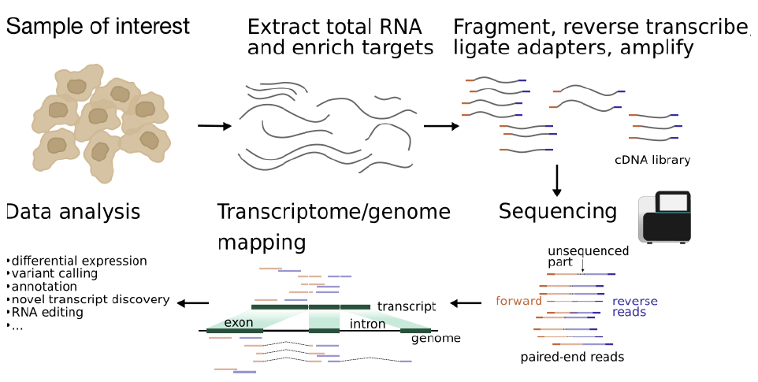
Typical bulk RNA-seq protocol (Prior exposure to RNA-seq is pre-requisite for the workshop)
Notes:
A typical RNA-seq protocol involves collection of biological specimen, isolation of RNA, cDNA library preparation, sequencing the cDNAs to get reads, querying a reference genome for origins of reads and downstream data analysis for differentially expressed genes, novel transcript discovery, etc.

Slide 3
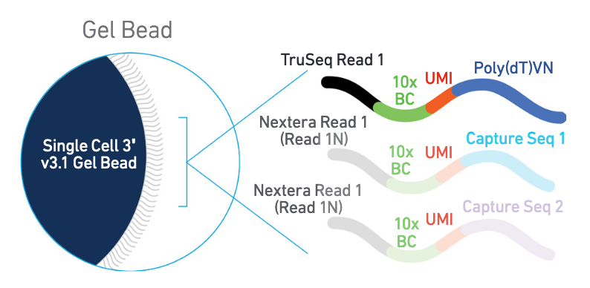
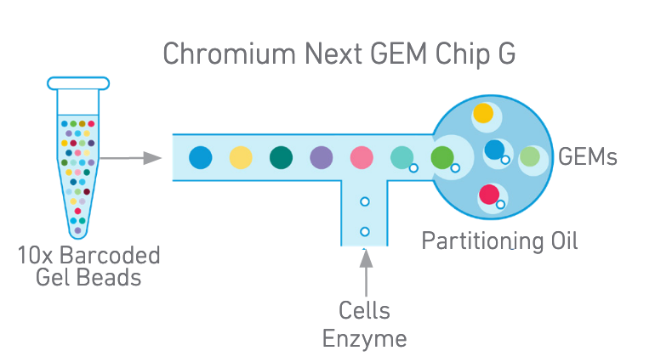
Single-cell technologies allow tagging cell-of-origin of reads with barcodes, which makes single-cell RNA-seq possible
Gel beads have poly(dT) primers to capture signal from polyadenylated mRNA and a unique barcode
Gel beads-in-emulsion (GEMs) are generated by combining gel beads and cells at high dilution
Notes:
For more on 10x Genomics technology, visit:
https://assets.ctfassets.net/an68im79xiti/D4H8F6Nt7tv3U30Bu9vAY/357f84ca07ab959009ead2b397e9e2e4/CG000315_ChromiumNextGEMSingleCell3__v3.1_Dual_Index_RevA.pdf

Slide 4
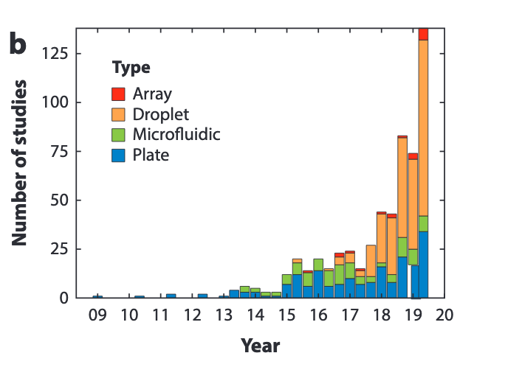
Analysis steps need to be adapted depending on the experimental protocol
Droplet technologies dominate because of higher throughput
See “Single Cell Sequencing - Eric Chow (UCSF)” for introduction to other technologies (link in notes)
(Image from Hie et al, 2020)
Notes:
References:
Hie, B., Peters, J., Nyquist, S. K., Shalek, A. K., Berger, B., & Bryson, B. D. (2020). Computational Methods for Single-Cell RNA Sequencing. Annual Review of Biomedical Data Science, 3.
For more on single-cell sequencing, watch video “Single Cell Sequencing - Eric Chow (UCSF)”:
https://www.youtube.com/watch?v=k9VFNLLQP8c

Slide 5
scRNA-seq applies where bulk RNA-seq may not
Identify new cell types
Investigate dynamics of developmental processes
Study gene regulatory mechanisms
…
In combination with spatial transcriptomics and single-cell multi-omics, applications in new areas are emerging rapidly

Slide 6
It might be possible to achieve project goals with experiment designs that avoid scRNA-seq
Testing for existence of new cell types?
Studying a diverse population with no known markers?
=> scRNA-seq may be useful
Can sort cells by FACS into sub-populations of interest?
=> bulk RNA-seq may suffice
…

Slide 7
Current limitations of scRNA-seq
Expensive
Typical studies are under-powered
Computational challenges
Technological
Not recommended for alternative splicing studies, low expressed genes, etc.
Low sample size
=> Data used to generate hypotheses that require testing
Notes:
Reference:
1. Jennifer Westoby, Pavel Artemov, Martin Hemberg, Anne Ferguson-Smith, Obstacles to Studying Alternative Splicing Using scRNA-seq, bioRxiv 797951; doi: https://doi.org/10.1101/797951

Slide 8
scRNA-seq analysis = Challenges with bulk RNA-seq analysis + More
Data is sparser than bulk RNA-seq
High dimensionality
Few replicates, if any
Technical noise, batch effects, …
Nonlinear gene expression dynamics
Gene | Cell #1 | … | Cell #10X
Gene #1 | 7 | 0 | 0
Gene #2 | 0 | 0 | 3
… | 0 | 0 | 0
… | 1 | 0 | 0
Gene #N | 4 | 0 | 1

Slide 9
Outline of Sessions 1-2
Introduction (15 mins)
Pre-processing raw sequencing data to get counts (20 mins)
Loading data in R using Seurat (15 mins)
Quality control (20 mins)
Normalization (30 mins)
Feature selection (10 mins)
Dimensionality reduction (10 + 40 mins)
Clustering (30 mins)
Finding marker genes (30 mins)
Additional information and Conclusion (20 mins)

Slide 10
Overall goals
To give an overview of current practices
Highlight assumptions and limitations underlying the methods
Understand the relevance and impact of intermediate steps
Experience how to analyze scRNA-seq data in R

Slide 11
More discussion later
Session 1: Load the data, quality control, normalization, feature selection, dimensionality reduction. (Mon)
Session 2: Dimensionality reduction (continued), clustering, finding marker genes. (Tues)
Session 3: Advanced discussion on normalization, differential analysis, and batch-correction. (Thurs)
Session 4: Network analysis of single-cell data, additional topics, Q&A. (Fri)

Slide 12
Read counts matrix
scRNA-seq steps:
✔️
Quality control and filter poor quality cells
Experiment design
Normalization
✔️
Library preparation
Feature selection
Deep sequencing
✔️
Dimensionality reduction
Demultiplex, align and count
(Pre-processing)
Clustering
…
…
Network analysis
Find marker genes
Trajectory analysis
Count matrix
Cell-type annotation
Gene set enrichment analysis
Association with phenotypes (e.g., healthy vs diseased)
…
…

Slide 13
1. Pre-processing raw sequencing data to count matrix (20 mins)

Slide 14
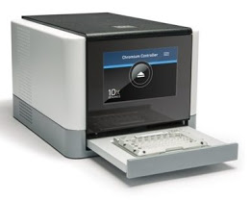
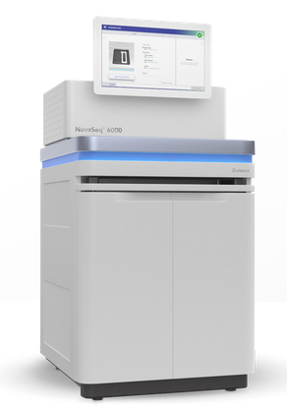






Pre-processing steps
Single cell RNA-seq library preparation (consult with the Genomics Core)
Deep sequencing (e.g., by UCSF CAT Core)
Wynton tutorial to move files from CAT Core (link in slide notes)
Pre-process raw data (e.g., using Cell Ranger from 10x Genomics pre-installed on Wynton)
QC runs and initial inspection (e.g., using Loupe Browser from 10x Genomics)
Notes:
How to download data to Wynton?
https://github.com/ucsf-wynton/tutorials/wiki/How-to-Move-Files

Slide 15
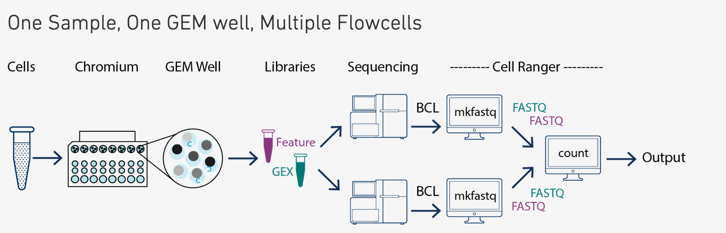
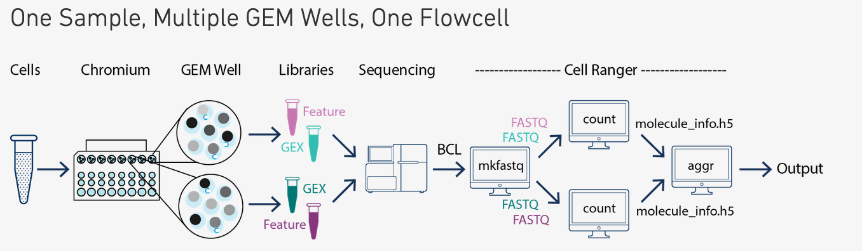
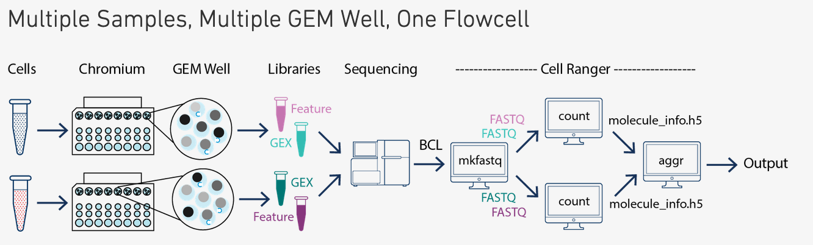
Cell Ranger pipeline available on Wynton from the CBI software repository
Demultiplex (BCL to FASTQ)
cellranger mkfastq
Alignment, filtering, barcode counting, and UMI counting
cellranger count
Aggregate counts from multiple runs
cellranger aggr
(Images from 10x Genomics website)
Notes:
What is Cell Ranger?
https://support.10xgenomics.com/single-cell-gene-expression/software/pipelines/latest/what-is-cell-ranger
For list of software in CBI and other repositories on Wynton:
https://wynton.ucsf.edu/hpc/software/software-repositories.html
How to submit jobs to Wynton compute nodes?
https://github.com/ucsf-wynton/tutorials/wiki/How-to-Submit-Jobs

Slide 16
Cell Ranger outputs include count matrices
BAM files with aligned reads
web_summary.html
Count matrices: ~20000 genes (rows) and ~6000 cells (columns)
Unfiltered matrices (all known-good barcodes, i.e., both cells and empty drops)
Filtered matrices (only cellular barcodes)
Matrix data organized in three files (see next slide)
Secondary analysis (e.g., dimensionality reduction, clustering, etc.)
Often ignored, e.g., perform secondary analysis using Seurat instead
Loupe file to interactively view secondary analysis results with Loupe Browser from 10x Genomics
Molecule info

Slide 17
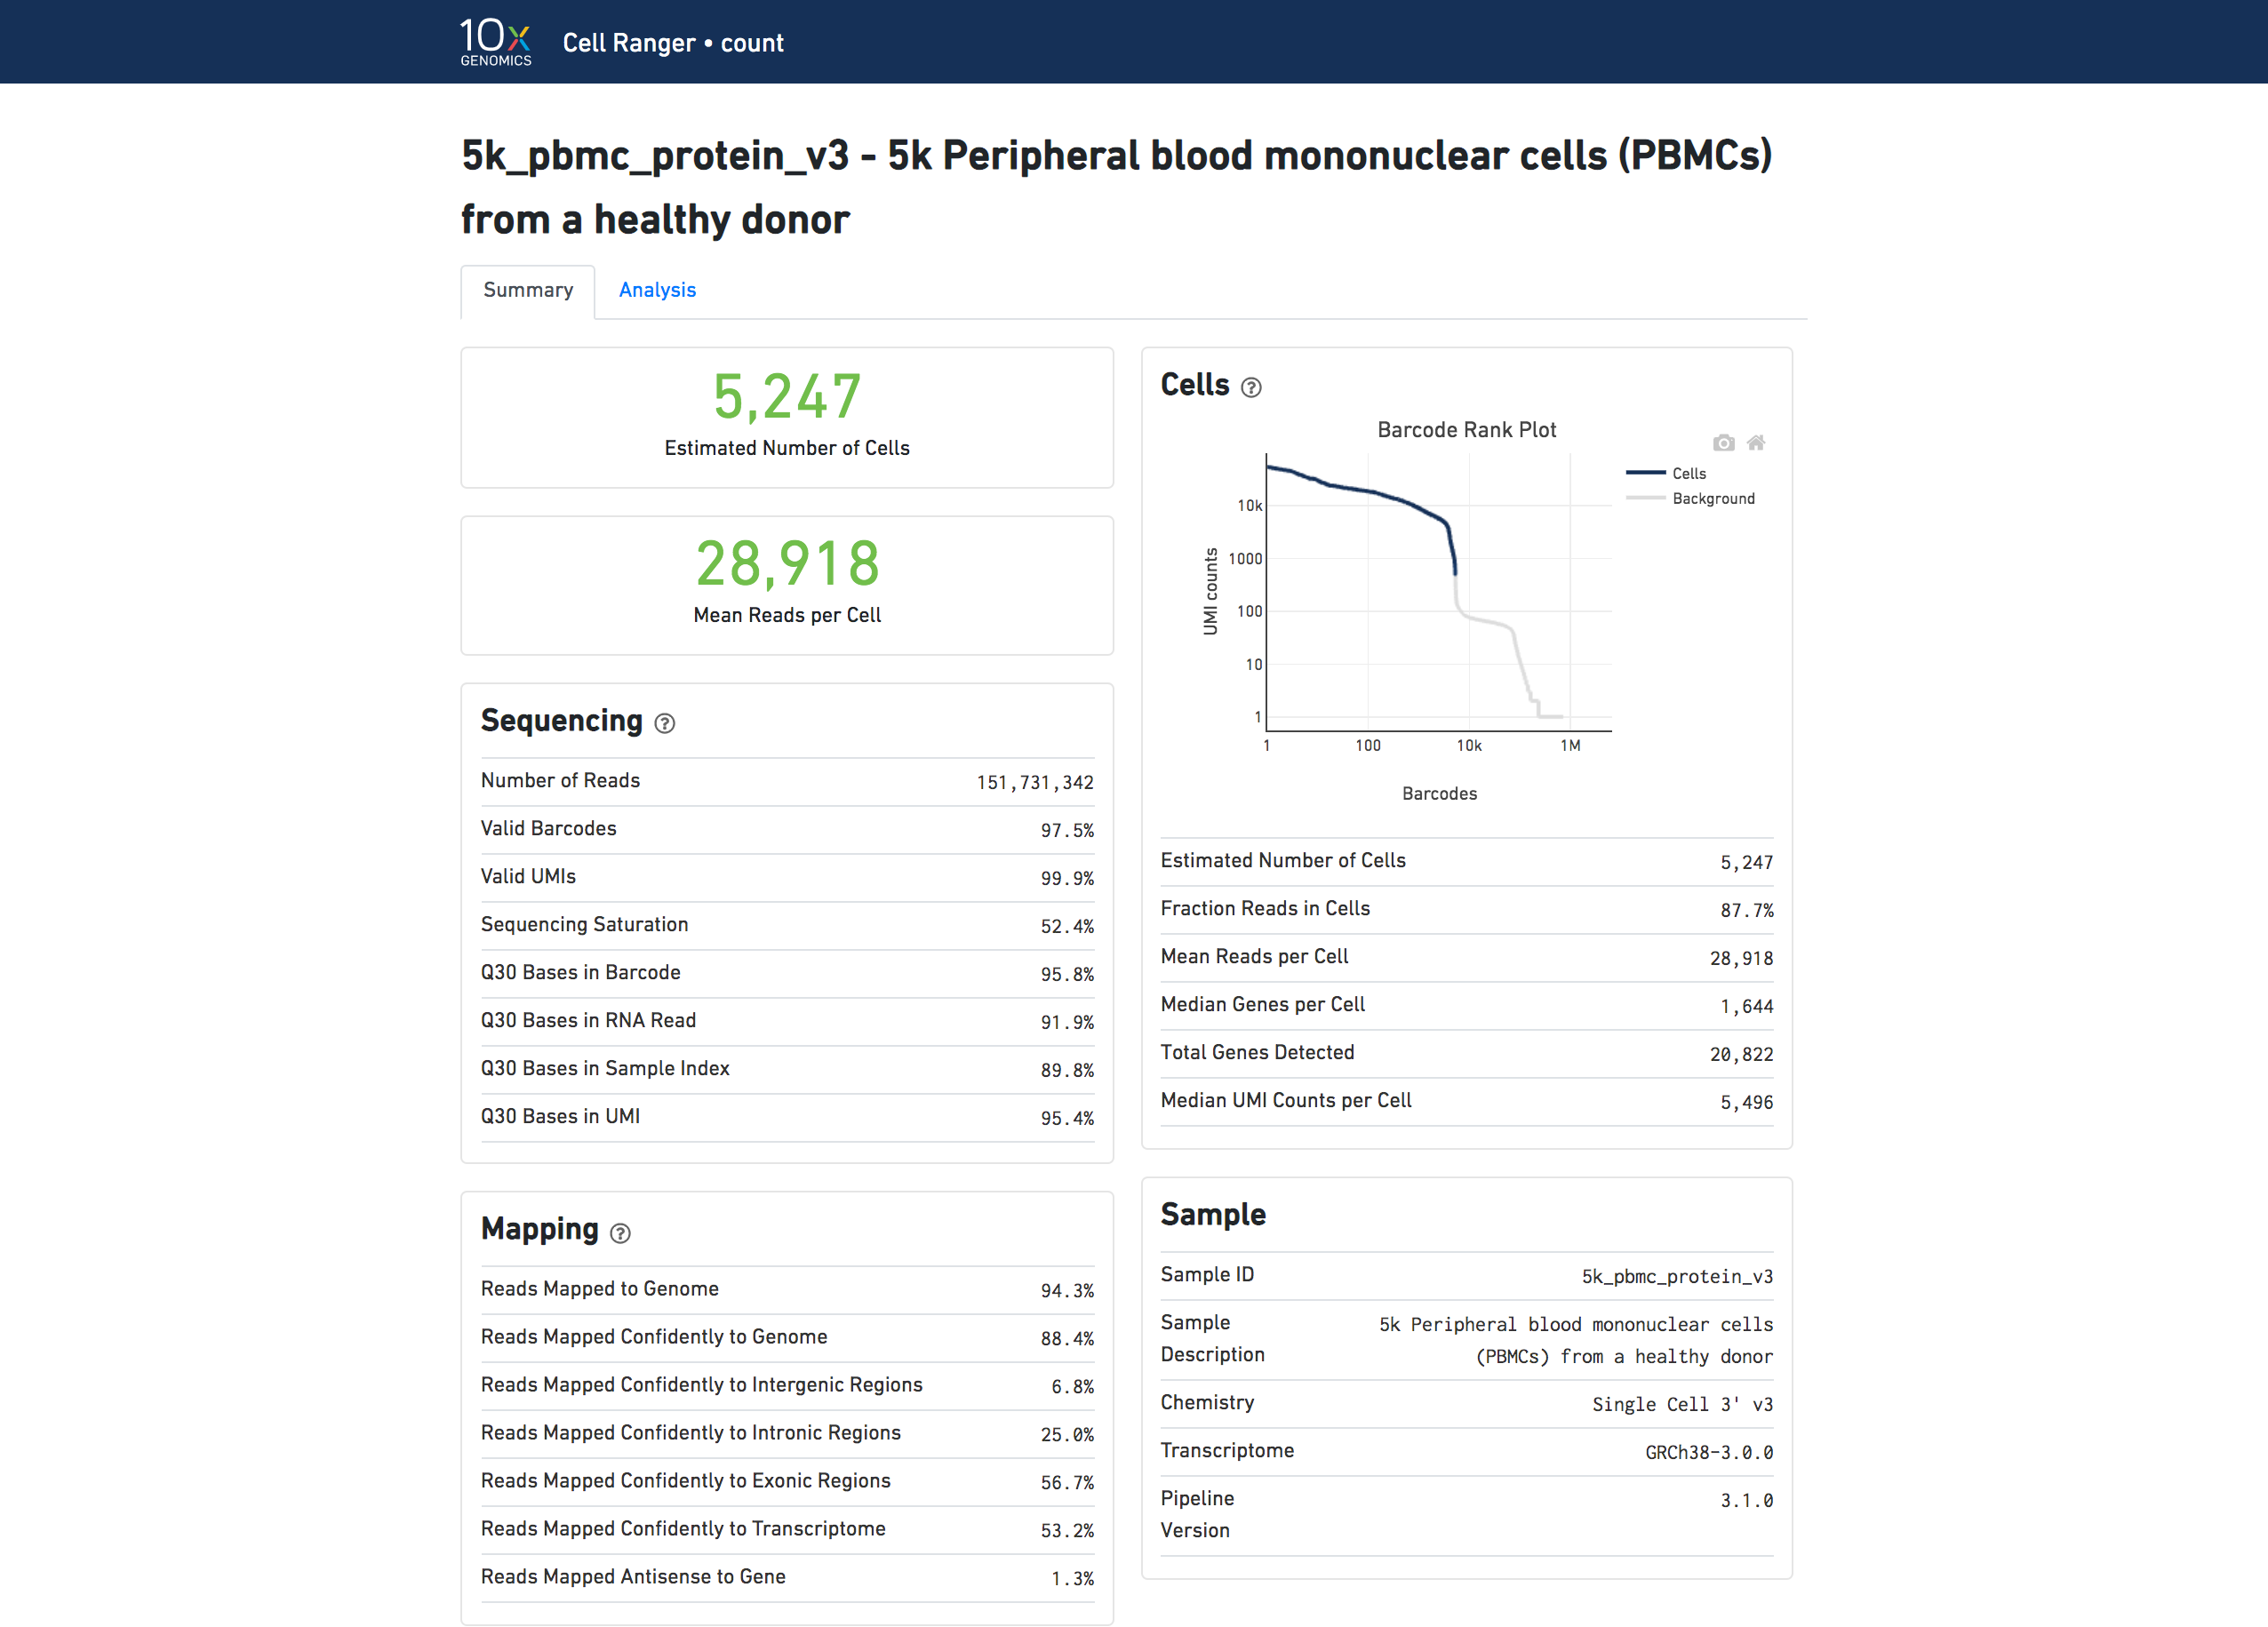
Cell Ranger outputs (more detail on HTML output)
web_summary.html
Sequencing metrics
Number of reads
Valid barcodes (%)
…
Mapping
Reads mapped (%)
Reads mapped to exons (%)
...
Cells
Number of cells
Reads in cells (%)
Median genes per cell
…
(Image from 10x Genomics website)

Slide 18
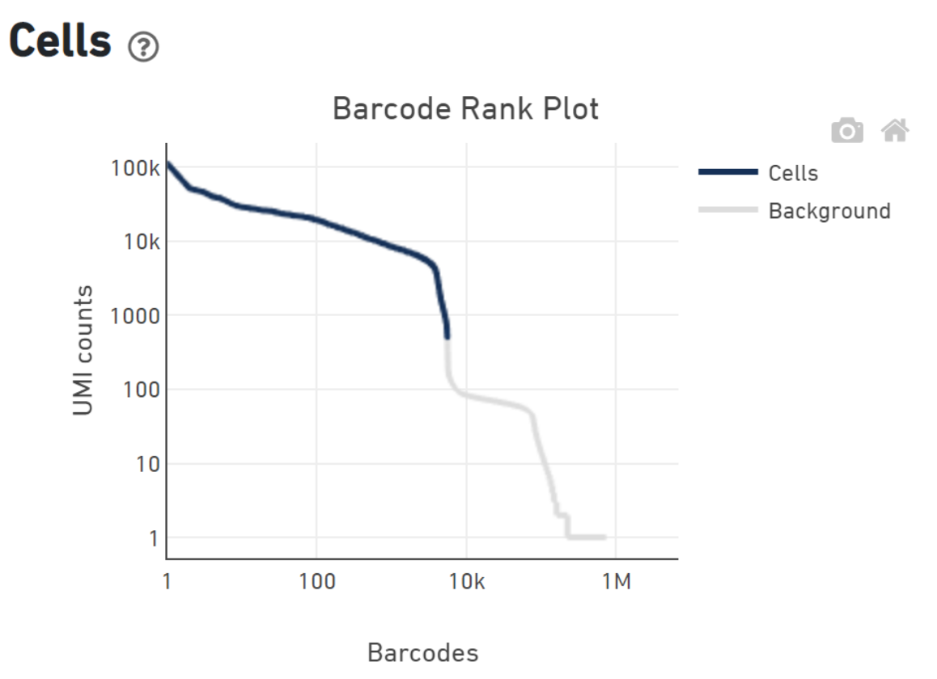
HTML output shows distribution of UMI counts, which is used to identify empty drops
Some drops have cells; many have ambient RNA (=> classification problem)
(Image from 10x Genomics website)
Notes:
How are barcodes classified as cell-associated? Visit:
https://kb.10xgenomics.com/hc/en-us/articles/115003480523-How-are-barcodes-classified-as-cell-associated-
For examples of barcode rank plot of compromised samples, visit:
https://assets.ctfassets.net/an68im79xiti/163qWiQBTVi2YLbskJphQX/e90bb82151b1cdab6d7e9b6c845e6130/CG000329_TechnicalNote_InterpretingCellRangerWebSummaryFiles_RevA.pdf

Slide 19
HTML output shows distribution of UMI counts, which is used to identify empty drops
Some drops have cells; many have ambient RNA (=> classification problem)
Assumption: UMI counts for cell-associated barcodes >> UMI counts for background-associated barcodes
Assumption: Gene-wise counts for cell-associated barcodes resemble expression profiles of real cells (based on the EmptyDrops method)
(Image from 10x Genomics website)
Notes:
How are barcodes classified as cell-associated? Visit:
https://kb.10xgenomics.com/hc/en-us/articles/115003480523-How-are-barcodes-classified-as-cell-associated-
For examples of barcode rank plot of compromised samples, visit:
https://assets.ctfassets.net/an68im79xiti/163qWiQBTVi2YLbskJphQX/e90bb82151b1cdab6d7e9b6c845e6130/CG000329_TechnicalNote_InterpretingCellRangerWebSummaryFiles_RevA.pdf

Slide 20
Cell Ranger outputs count matrices before and after filtering empty drops
Tools in common with bulk RNA-seq
Illumina’s bcl2fastq
STAR
FASTQ
Trim adapters
Map reads
Tally counts
Notes:
Reference:
1. https://github.com/gladstone-institutes/Bioinformatics-Workshops/wiki#rna-seq-analysis

Slide 21
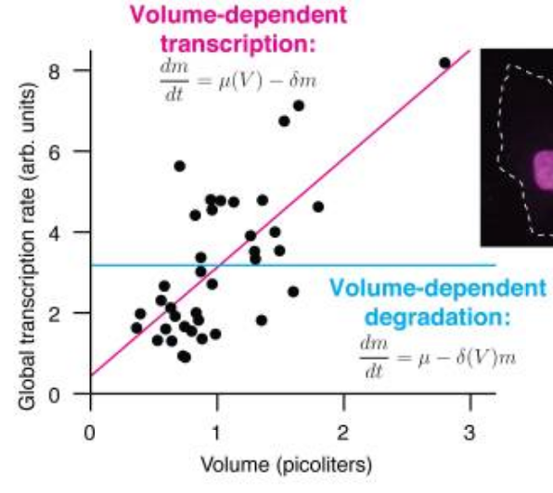
Additional consideration 1: Cell Ranger outputs filtered and unfiltered count matrices. Which one to use?
Say, there are cells of different sizes in the sample
Small cells might have low total RNA leading to low total UMI counts
Filtering all barcodes with less than certain UMI counts might filter small cells
EmptyDrops by Lun et al., 2019 compares count profile for each barcode with ambient RNA profile (similar implementation in Cell Ranger 3)
=> Small cells retained but empty drops removed
=> Alternative to Cell Ranger filtering
(Image from Padovan-Merhar et al, 2015)
Notes:
Method from the Marioni lab to identify empty drops:
Lun, A. T., Riesenfeld, S., Andrews, T., Gomes, T., & Marioni, J. C. (2019). EmptyDrops: distinguishing cells from empty droplets in droplet-based single-cell RNA sequencing data. Genome biology, 20(1), 1-9. https://genomebiology.biomedcentral.com/articles/10.1186/s13059-019-1662-y
Reference:
1. Padovan-Merhar, Olivia et al. “Single mammalian cells compensate for differences in cellular volume and DNA copy number through independent global transcriptional mechanisms.” Molecular cell vol. 58,2 (2015): 339-52. doi:10.1016/j.molcel.2015.03.005

Slide 22
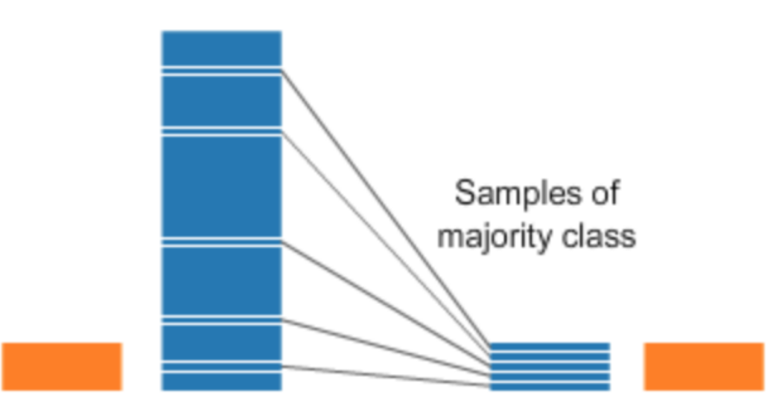
Additional consideration 2: Should we downsample reads when aggregating batches?
Say, multiple batches with different sequencing depths
By default, Cell Ranger downsamples deeper sequenced batches to equalize mapped read counts
DropletUtils allows to downsample UMI counts or read counts
Hafemeister and Satija, 2019 developed a count normalization method that recommends skipping downsampling (sctransform)
Downsampling
Sample #1
Sample #2
Sample #1
Sample #2
Before
After
Notes:
Method for normalization from the Satija lab:
Hafemeister, C., & Satija, R. (2019). Normalization and variance stabilization of single-cell RNA-seq data using regularized negative binomial regression. Genome biology, 20(1), 1-15. (also visit https://github.com/satijalab/seurat/issues/672)

Slide 23
Additional consideration 3: R vs Python vs Galaxy for the next steps
R (Seurat, Bioconductor, Monocle3, etc.)
R offers a rich collection of libraries for statistics and data science
Popular in academia
Bioconductor has a lot more than single-cell RNA-seq
Python (scanpy and other)
Much faster than R packages (5-90 times speedup for steps)
Easier access to advanced machine-learning packages (e.g., tensorflow)
Galaxy
R or Python tools can be installed
Provides GUI-based solution
Notes:
For more on analysis with Bioconductor, visit:
Amezquita, R.A., Lun, A.T.L., Becht, E. et al. Orchestrating single-cell analysis with Bioconductor. Nat Methods 17, 137–145 (2020). https://doi.org/10.1038/s41592-019-0654-x
https://osca.bioconductor.org/
For more on analysis with Seurat, visit:
https://satijalab.org/seurat/vignettes.html
Stuart, Tim, Andrew Butler, Paul Hoffman, Christoph Hafemeister, Efthymia Papalexi, William M. Mauck III, Yuhan Hao, Marlon Stoeckius, Peter Smibert, and Rahul Satija. "Comprehensive integration of single-cell data." Cell 177, no. 7 (2019): 1888-1902.
Butler, A., Hoffman, P., Smibert, P., Papalexi, E., & Satija, R. (2018). Integrating single-cell transcriptomic data across different conditions, technologies, and species. Nature biotechnology, 36(5), 411-420.
For more on analysis with scanpy, visit:
https://scanpy.readthedocs.io/en/stable/tutorials.html
Wolf, F. A., Angerer, P., & Theis, F. J. (2018). SCANPY: large-scale single-cell gene expression data analysis. Genome biology, 19(1), 15.
For more on analysis with Galaxy:
Graham J Etherington, Nicola Soranzo, Suhaib Mohammed, Wilfried Haerty, Robert P Davey, Federica Di Palma, A Galaxy-based training resource for single-cell RNA-sequencing quality control and analyses, GigaScience, Volume 8, Issue 12, December 2019, giz144, https://doi.org/10.1093/gigascience/giz144
https://www.ebi.ac.uk/training/online/course/single-cell-rna-seq-analysis-using-galaxy

Slide 24
Read counts matrix
scRNA-seq steps:
✔️
Quality control and filter poor quality cells
Experiment design
Normalization
Library preparation
✔️
Feature selection
Deep sequencing
✔️
Dimensionality reduction
Demultiplex, align and count
(Pre-processing)
Clustering
✔️
…
…
Network analysis
✔️
Find marker genes
Trajectory analysis
Count matrix
Cell-type annotation
Gene set enrichment analysis
Association with phenotypes (e.g., healthy vs diseased)
…
…

Slide 25
2. Loading data in R using Seurat (15 mins)

Slide 26
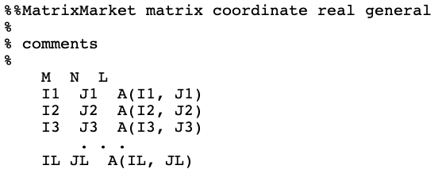
Count data is organized in three files (1/3)
matrix.mtx.gz
.gz :- Compression format
.mtx :- Matrix Market Exchange format
Favored for sparse matrices (mostly zero entries)
Consider table with 20k rows and 6k columns:
# of genes (~10⁴)
# of cellular barcodes (~10⁴)
# non-zero entries (~10⁶)
=> sparse matrix
.mtx format
# non-zero entries
# genes
# barcodes
entry at IL and JL
column index
row index
Notes:
Visit for more details on output files:
https://kb.10xgenomics.com/hc/en-us/articles/115000794686-How-is-the-MEX-format-used-for-the-gene-barcode-matrices-
Example content of a .mtx file:
%%MatrixMarket matrix coordinate real general
%=================================================================================
%
% This ASCII file represents a sparse MxN matrix with L
% nonzeros in the following Matrix Market format:
%
% +----------------------------------------------+
% |%%MatrixMarket matrix coordinate real general | <--- header line
% |% | <--+
% |% comments | |-- 0 or more comment lines
% |% | <--+
% | M N L | <--- rows, columns, entries
% | I1 J1 A(I1, J1) | <--+
% | I2 J2 A(I2, J2) | |
% | I3 J3 A(I3, J3) | |-- L lines
% | . . . | |
% | IL JL A(IL, JL) | <--+
% +----------------------------------------------+ %
% Indices are 1-based, i.e. A(1,1) is the first element.
%
%=================================================================================
5 5 8
1 1 1.000e+00
2 2 1.050e+01
3 3 1.500e-02
1 4 6.000e+00
4 2 2.505e+02
4 4 -2.800e+02
4 5 3.332e+01
5 5 1.200e+01

Slide 27
Count data is organized in three files (2/3)
‘Feature’ is data science jargon for any measurable property
In scRNA-seq, feature = expression level of a gene
Gene identifiers are stored in features.tsv.gz
Order is the same as order of rows in matrix.mtx.gz
Example:
ENSMUSG00000051951 Xkr4 Gene Expression
ENSMUSG00000089699 Gm1992 Gene Expression
ENSMUSG00000102331 Gm19938 Gene Expression
… … …
… … …
… … …

Slide 28
Count data is organized in three files (3/3)
Each cell is identified by a barcode
List of barcodes is saved in barcodes.tsv.gz
Order is same as order of columns in matrix.mtx.gz
Numeric suffix after barcode sequence gives sample number in aggregated matrix
Example:
AAACCCAAGCATCCTA-1
AAACCCAAGCGTGTTT-1
…
…
TTTGGAGCAAATCGTC-24
TTTGGAGGTCAAGCCC-24

Slide 29
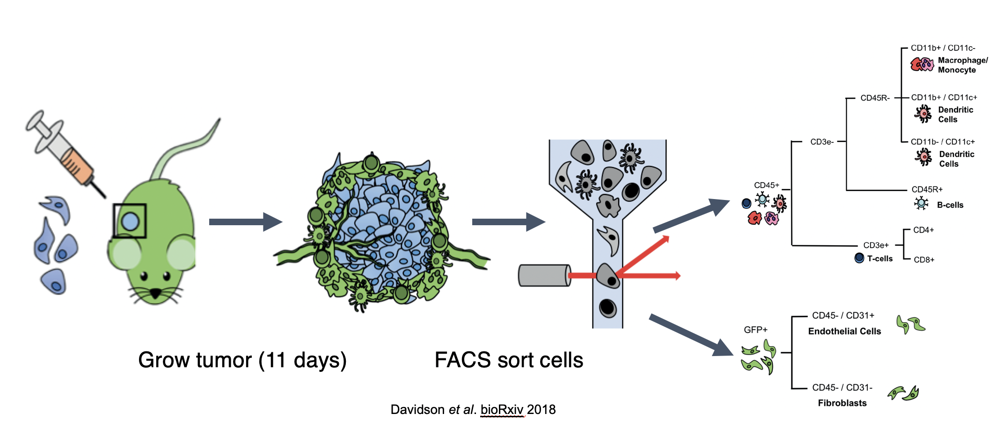
Data for this workshop
Two groups
Multiple time points
Replicates
Analysis led to new cell types
(Image from Davidson et al, 2020)
Notes:
References for data:
https://www.ebi.ac.uk/gxa/sc/experiments/E-EHCA-2/results/tsne
Davidson, Sarah, Mirjana Efremova, Angela Riedel, Bidesh Mahata, Jhuma Pramanik, Jani Huuhtanen, Gozde Kar et al. "Single-Cell RNA Sequencing Reveals a Dynamic Stromal Niche That Supports Tumor Growth." Cell reports 31, no. 7 (2020): 107628.

Slide 30

Load the data in R using the Read10X function from the Seurat package and create Seurat object
R package Seurat is named after a 19th century French artist, George Seurat
See the R script
Detail from George Seurat's Parade de cirque, 1889. Note the contrasting dots of paint that make up the portrait.
(Public domain image)

Slide 31
Seurat object contains all the relevant information
Data
raw counts
normalized counts
Metadata about cells
# genes detected
phenotype
…
Analysis results
Other single-cell assay data for multimodal analysis
Notes:
For a detailed description of the Seurat object class, visit:
https://www.rdocumentation.org/packages/Seurat/versions/3.1.4/topics/seurat-class

Slide 32
Seurat object can be converted to formats required by Bioconductor and scanpy
When a method gets popular, implementations appear on all platforms
New developments often only available from the developers
Functions are available to convert the objects to different formats
Notes:
How to convert between Bioconductor, Seurat and Scanpy objects? Visit:
https://satijalab.org/seurat/v3.1/conversion_vignette.html

Slide 33
Read counts matrix
✔️
scRNA-seq steps:
✔️
Quality control and filter poor quality cells
Experiment design
Normalization
Library preparation
✔️
Feature selection
Deep sequencing
✔️
Dimensionality reduction
Demultiplex, align and count
(Pre-processing)
Clustering
✔️
…
…
Network analysis
✔️
Find marker genes
Trajectory analysis
Count matrix
Cell-type annotation
Gene set enrichment analysis
Association with phenotypes (e.g., healthy vs diseased)
…
…

Slide 34
3. Quality control (20 mins)

Slide 35
Not all barcodes represent good quality cells Not all genes are detected in all cells => Filtering of poor quality or uninteresting data needed
Common filtering criteria:
# genes detected in a cell
If too few, empty drops or dead cells?
If too many, doublets or multiplets?
# unique molecules in a cell
Percent of mitochondrial genes
If too high, low quality/dying cells?
See the R script

Slide 36
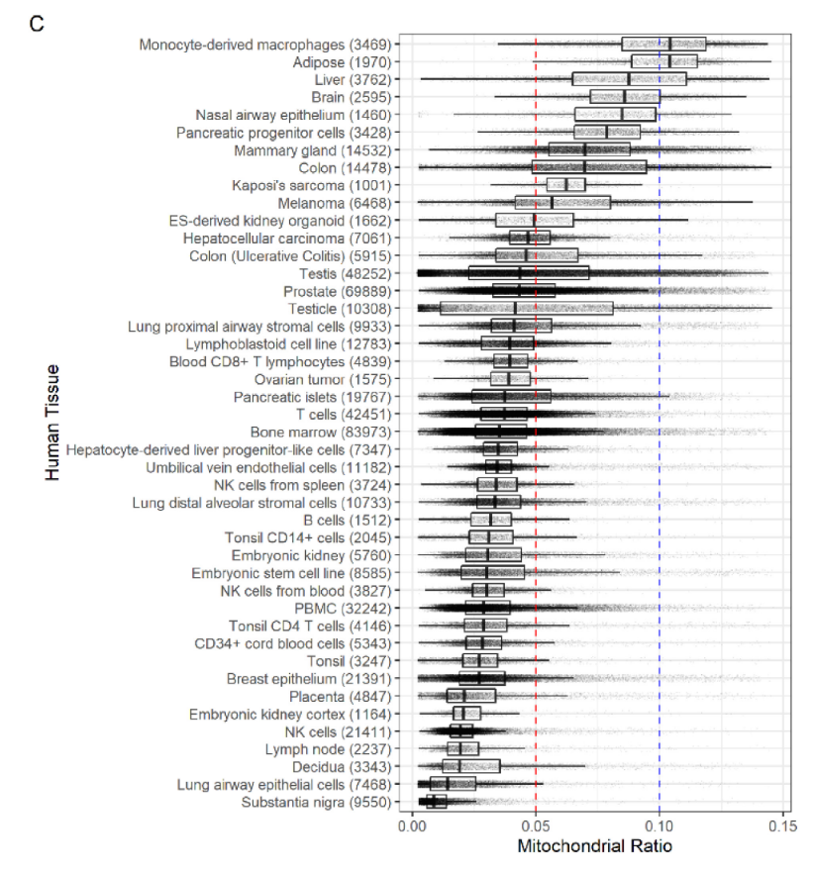
Additional consideration 1: Careful selection of mitochondrial % cutoff for filtering important
Mitochondrial transcripts indicate cell stress
“Normal” value depends on the cell type
Ex. 1: 30% maybe normal for cardiomyocytes
Ex. 2: 30% in lymphocyte => stress
Osorio and Cai, 2020 studied published data
5% cutoff for mouse cells performed well
for humans, a higher cutoff required (proposed 10%)
provided reference values for range of human/mouse cell types and tissues
scater provides methods that adapt cutoffs to data
any cell with QC metrics >3 MAD from median across all cells is outlier
(Image from Osorio and Cai, 2020)
Notes:
References:
AlJanahi, A. A., Danielsen, M., & Dunbar, C. E. (2018). An introduction to the analysis of single-cell RNA-sequencing data. Molecular Therapy-Methods & Clinical Development, 10, 189-196.
Daniel Osorio, James J Cai, Systematic determination of the mitochondrial proportion in human and mice tissues for single-cell RNA-sequencing data quality control, Bioinformatics, , btaa751, https://doi.org/10.1093/bioinformatics/btaa751
McCarthy, D. J., Campbell, K. R., Lun, A. T., & Wills, Q. F. (2017). Scater: pre-processing, quality control, normalization and visualization of single-cell RNA-seq data in R. Bioinformatics, 33(8), 1179-1186.

Slide 37
Additional consideration 2: What causes doublets and how to identify them
Ideal world => all drops have a single cell
Real world =>
some drops have multiple cells
there is chance at play
some cell types are harder to separate
many drops have no cells
Droplet
Cell #1
Bead
Cell #2

Slide 38
Count-based filtering assumes all cells have equal total mRNAs May not be true => Other tools to detect doublets
DoubletFinder (McGinnis et al, 2019) and Scrublet (Wolock et al., 2019)
Simulate doublets by averaging expression profile of random pair of cells
Barcodes with profiles close to simulated doublets represent doublets
Limitation: Mixed-lineage cell states may be present with hybrid transcriptomes
DoubletDecon, scds, Solo, …
Notes:
References:
1. McGinnis, C. S., Murrow, L. M., & Gartner, Z. J. (2019). DoubletFinder: doublet detection in single-cell RNA sequencing data using artificial nearest neighbors. Cell systems, 8(4), 329-337.
2. Wolock, S. L., Lopez, R., & Klein, A. M. (2019). Scrublet: computational identification of cell doublets in single-cell transcriptomic data. Cell systems, 8(4), 281-291.

Slide 39
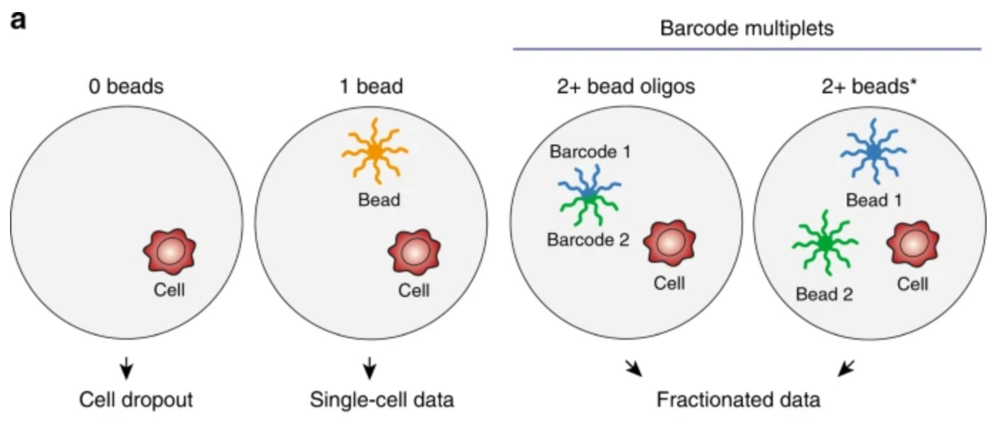
Additional consideration 3: Barcode multiplets vs cell multiplets
10x Genomics does “super-loading” of beads
Some drops may have one cell but multiple beads
=> leads to barcodes with fractionated single-cell data (Lareau et al, 2020)
Can lead to mischaracterizing artifacts as new cell types
Not part of typical analysis currently
(Image from Lareau et al., 2020)
Notes:
References:
Lareau, C. A., Ma, S., Duarte, F. M., & Buenrostro, J. D. (2020). Inference and effects of barcode multiplets in droplet-based single-cell assays. Nature communications, 11(1), 1-9.
Suggested reading on sub-Poisson loading of beads:
https://liorpachter.wordpress.com/2019/02/07/sub-poisson-loading-for-single-cell-rna-seq/

Slide 40
FAQ: How to identify the mitochondrial genes?
Mitochondrial gene symbols start with
“mt-” for mouse
“MT-” for humans

Slide 41
FAQ: Why is there high expression of Malat1?
Dead/dying cells may manifest high expression of Malat1
Ensure that cells with high levels of Malat1 are not dying cells before making inference about their biology
https://kb.10xgenomics.com/hc/en-us/articles/360004729092-Why-do-I-see-high-levels-of-Malat1-in-my-gene-expression-data-
Notes:
Suggested reading:
https://kb.10xgenomics.com/hc/en-us/articles/360004729092-Why-do-I-see-high-levels-of-Malat1-in-my-gene-expression-data-

Slide 42
Read counts matrix
✔️
scRNA-seq steps:
✔️
Quality control and filter poor quality cells
Experiment design
✔️
Normalization
Library preparation
✔️
Feature selection
Deep sequencing
✔️
Dimensionality reduction
Demultiplex, align and count
(Pre-processing)
Clustering
✔️
…
…
Network analysis
✔️
Find marker genes
Trajectory analysis
Count matrix
Cell-type annotation
Gene set enrichment analysis
Association with phenotypes (e.g., healthy vs diseased)
…
…

Slide 43
4. Normalization (30 mins)

Slide 44
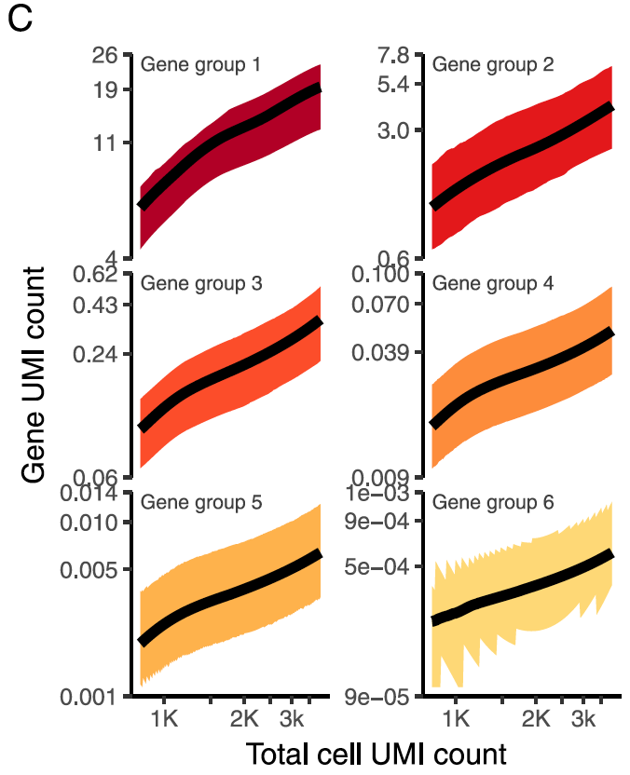
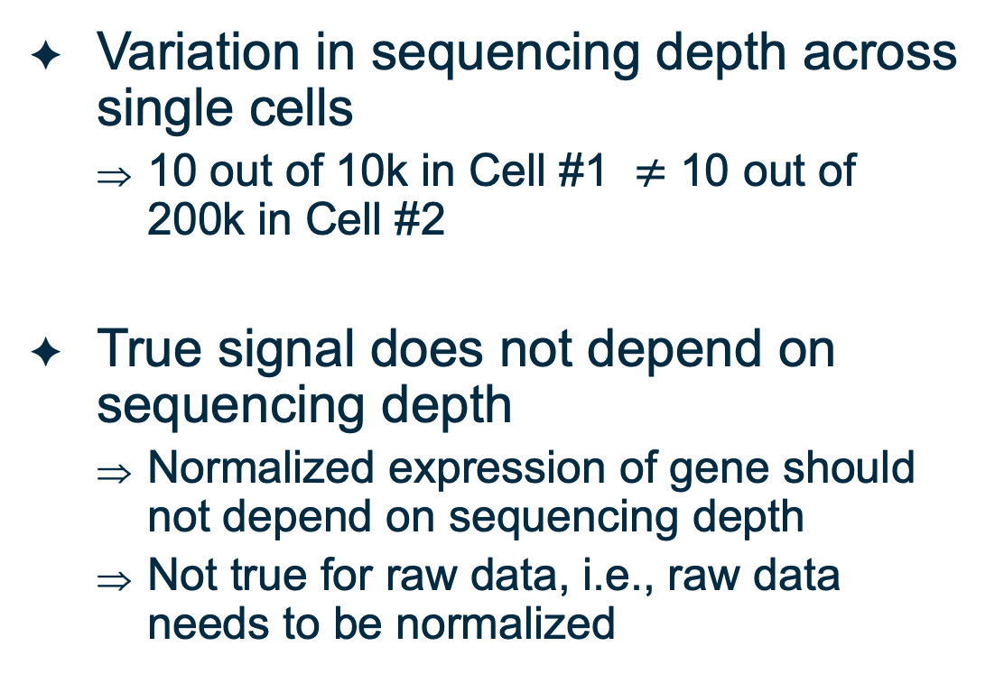
Why need to normalize?
Variation in sequencing depth across single cells
10 out of 10k in Cell #1 $≠$ 10 out of 200k in Cell #2
True signal does not depend on sequencing depth
Normalized expression of gene should not depend on sequencing depth
Not true for raw data, i.e., raw data needs to be normalized
(Image from Hafemeister and Satija, 2019)
Notes:
References:
1. Hafemeister, C., & Satija, R. (2019). Normalization and variance stabilization of single-cell RNA-seq data using regularized negative binomial regression. Genome biology, 20(1), 1-15.

Slide 45
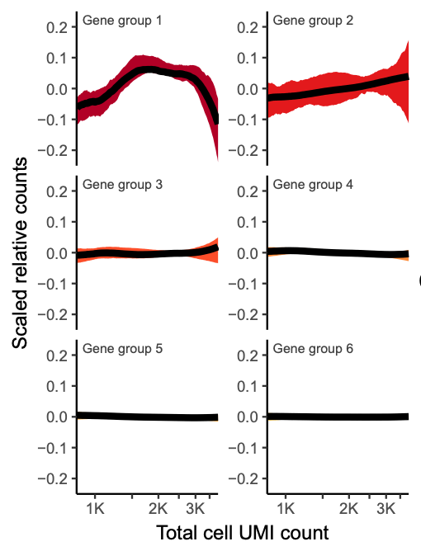
Raw counts divided by total sequencing depth (relative counts) are not properly normalized
(Image from Hafemeister and Satija, 2019)

Slide 46
Standard workflows in Seurat and scanpy utilize log-normalization Steps: 1. Divide by total, 2. Scale and add pseudo-count, 3. log-transform
Inspired by bulk RNA-seq data
Reason 1:
gene counts range over several orders of magnitude in bulk data
direct comparison of large numbers not ideal
log-normalization enables interpretation of differences as log of fold change
Reason 2:
variance of a gene’s counts is proportional to its mean
log-normalization prevents highly expressed genes from dominating analysis
Before UMI usage in scRNA-seq
single-cell data had counts ranging over several orders of magnitude
=> log-normalization was adopted
UMI data have lots of zeros and do not have large counts but log-normalized
Notes:
Refernces:
1. Townes, F.W., Hicks, S.C., Aryee, M.J. et al. Feature selection and dimension reduction for single-cell RNA-Seq based on a multinomial model. Genome Biol 20, 295 (2019). https://doi.org/10.1186/s13059-019-1861-6

Slide 47
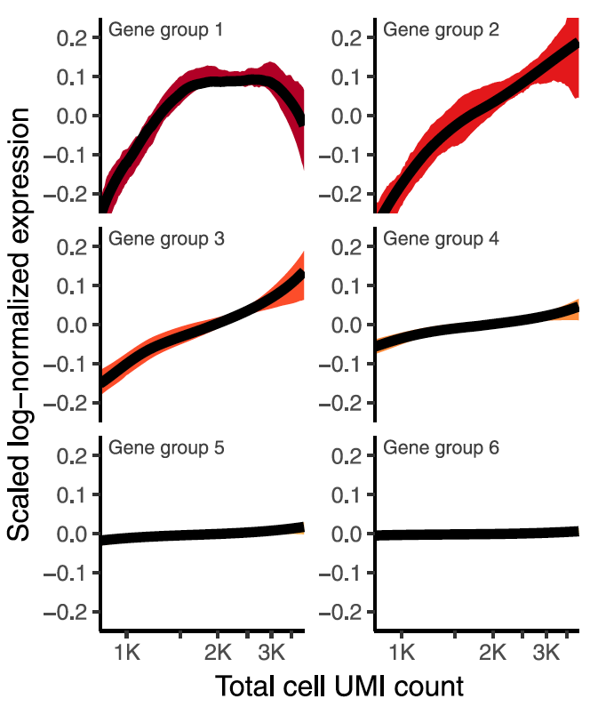
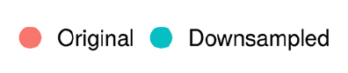
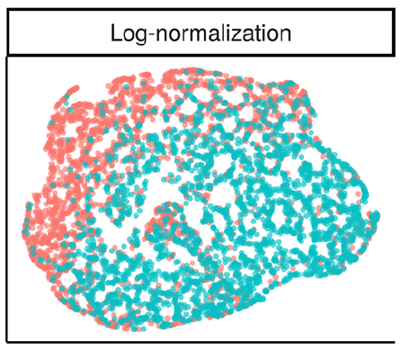
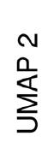
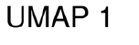
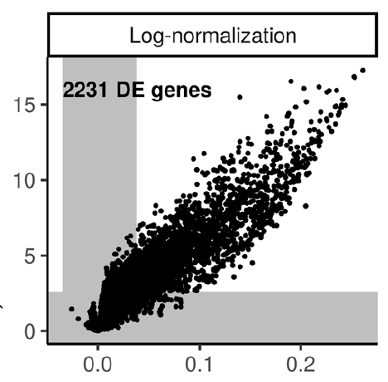
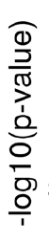
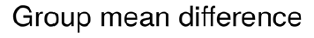
Log-normalized counts not independent of total count
Identical scaling for all genes => Different effects for genes with overall different expression levels
Comparison of a dataset with its down-sampled version identified >2000 DE genes at FDR<0.01!
a
b
c
(Figures from Hafemeister and Satija, 2019)

Slide 48
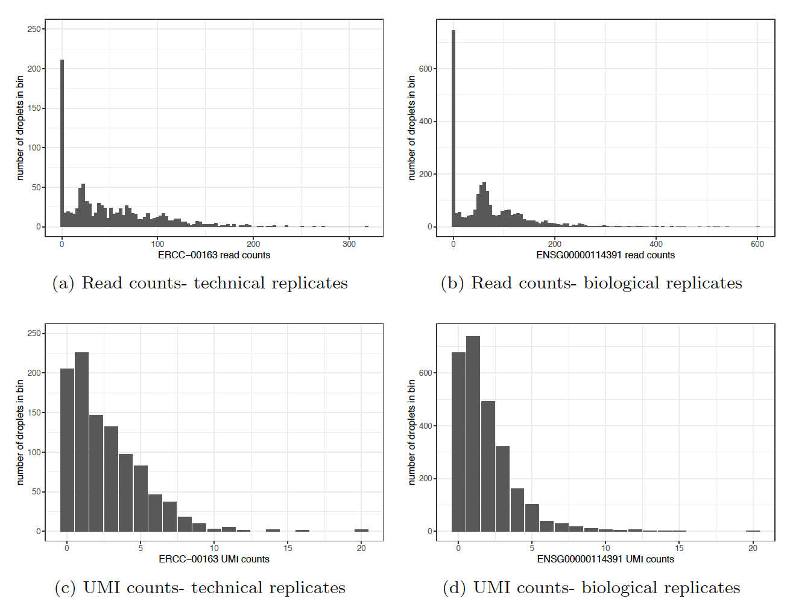
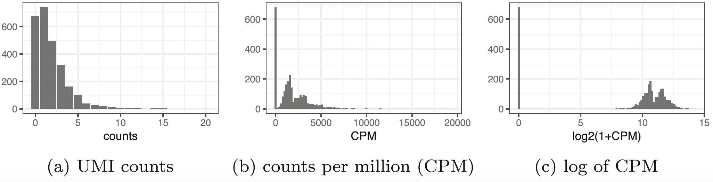
log-transformation distorts the count distributions
“… the log transformation is not necessary and in fact detrimental for the analysis of UMI counts” – Townes et al., 2019
Notes:
References:
Townes, F.W., Hicks, S.C., Aryee, M.J. et al. Feature selection and dimension reduction for single-cell RNA-Seq based on a multinomial model. Genome Biol 20, 295 (2019). https://doi.org/10.1186/s13059-019-1861-6
Svensson, V. Droplet scRNA-seq is not zero-inflated. Nat Biotechnol 38, 147–150 (2020). https://doi.org/10.1038/s41587-019-0379-5

Slide 49
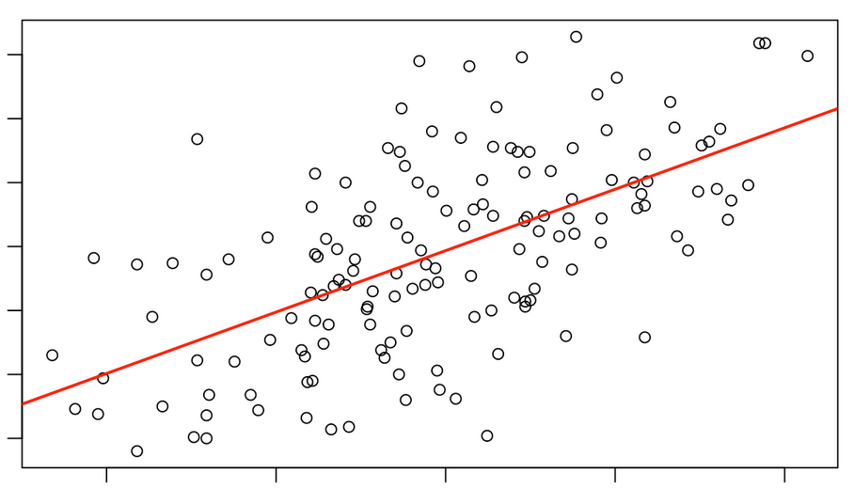
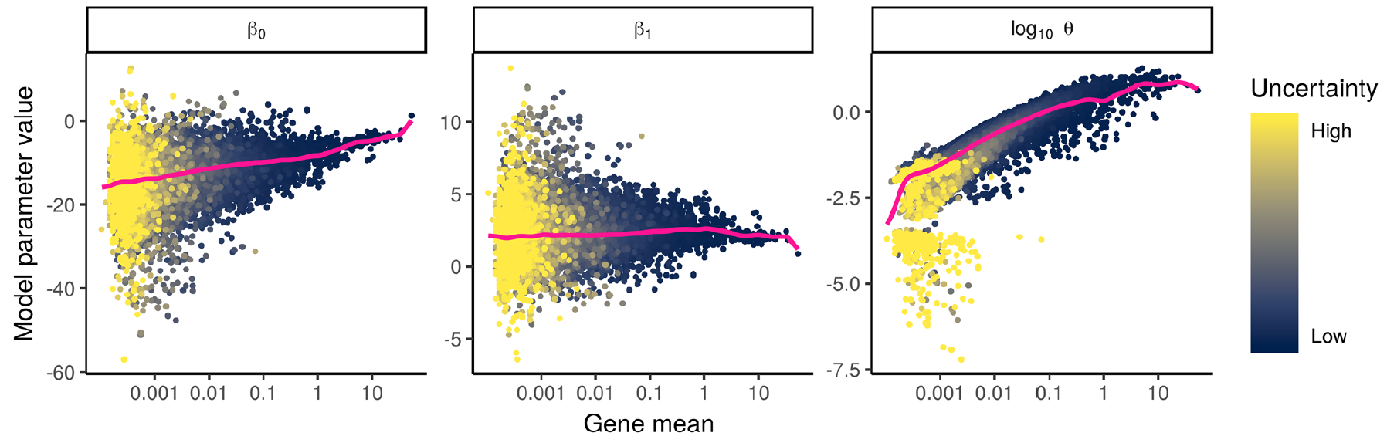
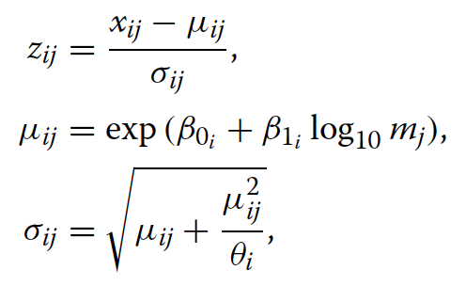
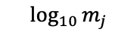
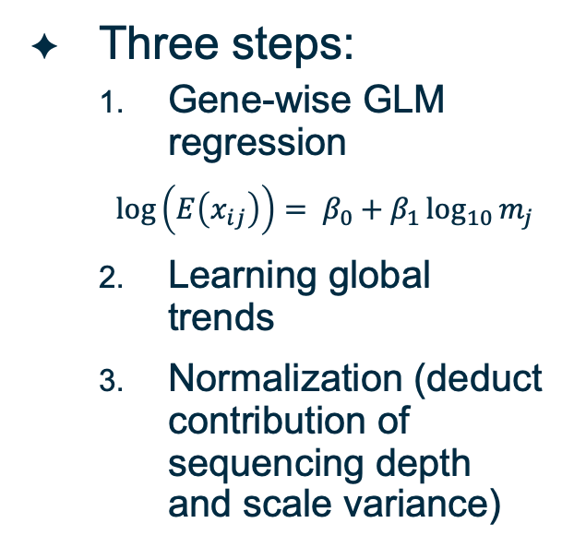
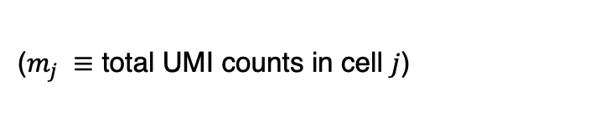
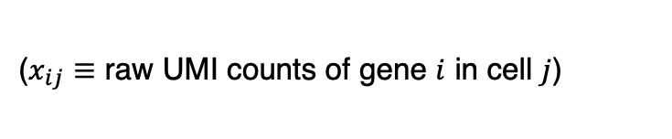
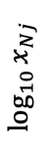
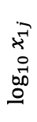
sctransform is a method from the Seurat developers (shown to perform better than their standard workflow)
($x_{ij}≡$ raw UMI counts of gene $i$ in cell $j$)
Three steps:
Gene-wise GLM regression
$\log\left(E\left(x_{ij}\right)\right)= β_{0}+β_{1}\log_{10}{m_{j}}$
Learning global trends
Normalization (deduct contribution of sequencing depth and scale variance)
($m_{j} ≡$ total UMI counts in cell $j$)
Step #1
$$\log_{10}{x_{1j}}$$
…
$$\log_{10}{x_{Nj}}$$
$$\log_{10}{m_{j}}$$
$$\log_{10}{m_{j}}$$
Step #2
(Figure from Hafemeister and Satija, 2019)

Slide 50
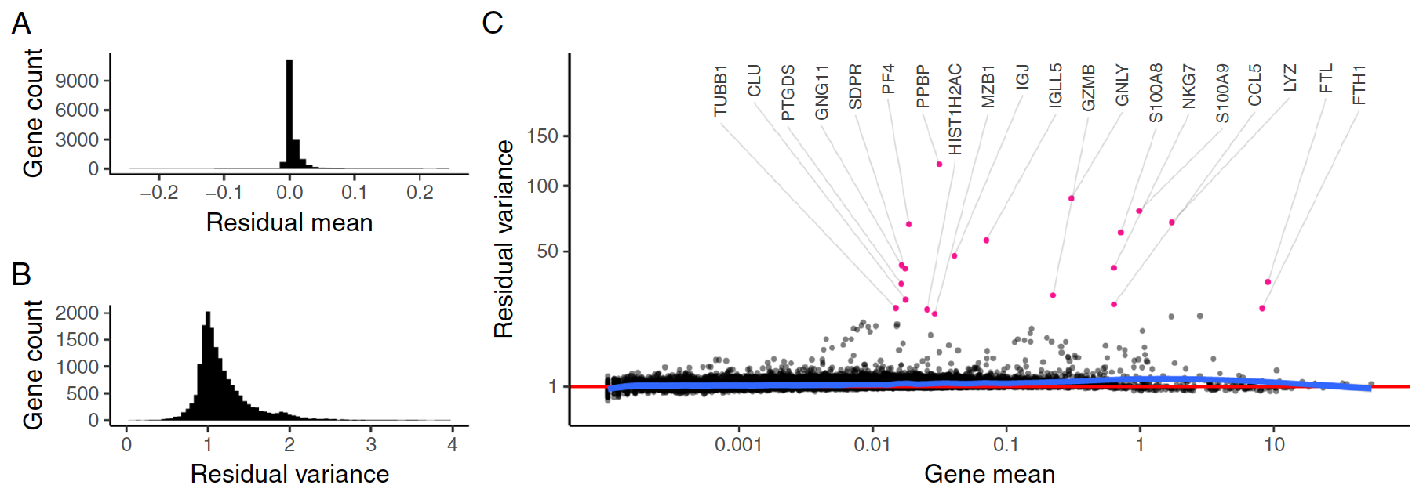
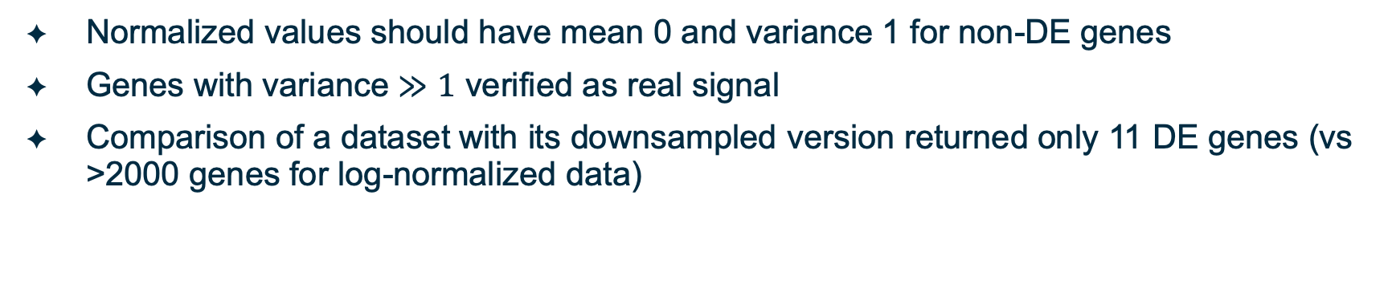
Characteristics of sctransform-normalized data
Normalized values should have mean 0 and variance 1 for non-DE genes
Genes with variance $≫1$ verified as real signal
Comparison of a dataset with its downsampled version returned only 11 DE genes (vs >2000 genes for log-normalized data)
(Figure from Hafemeister and Satija, 2019)

Slide 51
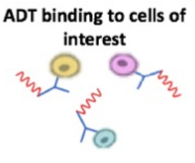
Another normalization method in Seurat– Centered log-ratio (CLR) transformation
Recommended for CITE-seq data
CITE-seq assays mRNAs and 10s of surface proteins simultaneously
~ uses antibody-derived oligonucleotide tags (ADT)
Due to few proteins, problems with compositional data amplified
Sequencing depth is constant => sum of protein-wise counts is constant
Can artificially lead to correlations
Example- The relative counts for a protein cannot increase without decreasing for other proteins
CLR addresses this issue
Sample #1
Sample #2
Raw counts | Relative counts
7 | 0.7
1 | 0.1
2 | 0.2
Raw counts | Relative counts
70 | 0.958
1 | 0.014
2 | 0.028
Notes:
Reference:
1. Stoeckius, Marlon, Christoph Hafemeister, William Stephenson, Brian Houck-Loomis, Pratip K. Chattopadhyay, Harold Swerdlow, Rahul Satija, and Peter Smibert. "Simultaneous epitope and transcriptome measurement in single cells." Nature methods 14, no. 9 (2017): 865.

Slide 52
Other methods to normalize
Use size-factors that account for compositional differences in transcriptomes of cells
Total UMI counts is representative of sequencing depth if total mRNA content of all cells is identical
scran allows better estimation of the size-factors
Normalize using spike-ins
…
Notes:
References:
Lun ATL, McCarthy DJ, Marioni JC (2016). “A step-by-step workflow for low-level analysis of single-cell RNA-seq data with Bioconductor.” F1000Res., 5, 2122. doi: 10.12688/f1000research.9501.2.
Amezquita, R.A., Lun, A.T.L., Becht, E. et al. Orchestrating single-cell analysis with Bioconductor. Nat Methods 17, 137–145 (2020). https://doi.org/10.1038/s41592-019-0654-x

Slide 53
Normalization is a critical step More discussion on this on Thursday
Session 1: Load the data, quality control, normalization, feature selection, dimensionality reduction. (Mon)
Session 2: Dimensionality reduction (continued), clustering, finding marker genes. (Tues)
Session 3: Advanced discussion on normalization, differential analysis, and batch-correction. (Thurs)
Session 4: Network analysis of single-cell data, additional topics, Q&A. (Fri)

Slide 54
Read counts matrix
✔️
scRNA-seq steps:
✔️
Quality control and filter poor quality cells
Experiment design
✔️
Normalization
✔️
Library preparation
✔️
Feature selection
To be continued
Deep sequencing
✔️
Dimensionality reduction
Demultiplex, align and count
(Pre-processing)
Clustering
✔️
…
…
Network analysis
✔️
Find marker genes
Trajectory analysis
Count matrix
Cell-type annotation
Gene set enrichment analysis
Association with phenotypes (e.g., healthy vs diseased)
Session I summary
…
…

Slide 55
End of Session I

Slide 56
Session 2

Slide 57
Topics for Session 2
Feature selection (10 mins)
Dimensionality reduction (40 mins)
Select a subset of principal components
Nonlinear dimensionality reduction
Impact of parameter selection
Clustering (30 mins)
Find marker genes (20 mins)
Additional information and Conclusion (10 mins)

Slide 58
5. Feature selection (10 mins)

Slide 59
Why work with select features (genes)?
In a typical study, most genes may not be relevant
=> Variation in most genes is technical or inherent biological noise
Feature selection may improve signal-to-noise ratio
Feature selection may improve computational efficiency

Slide 60
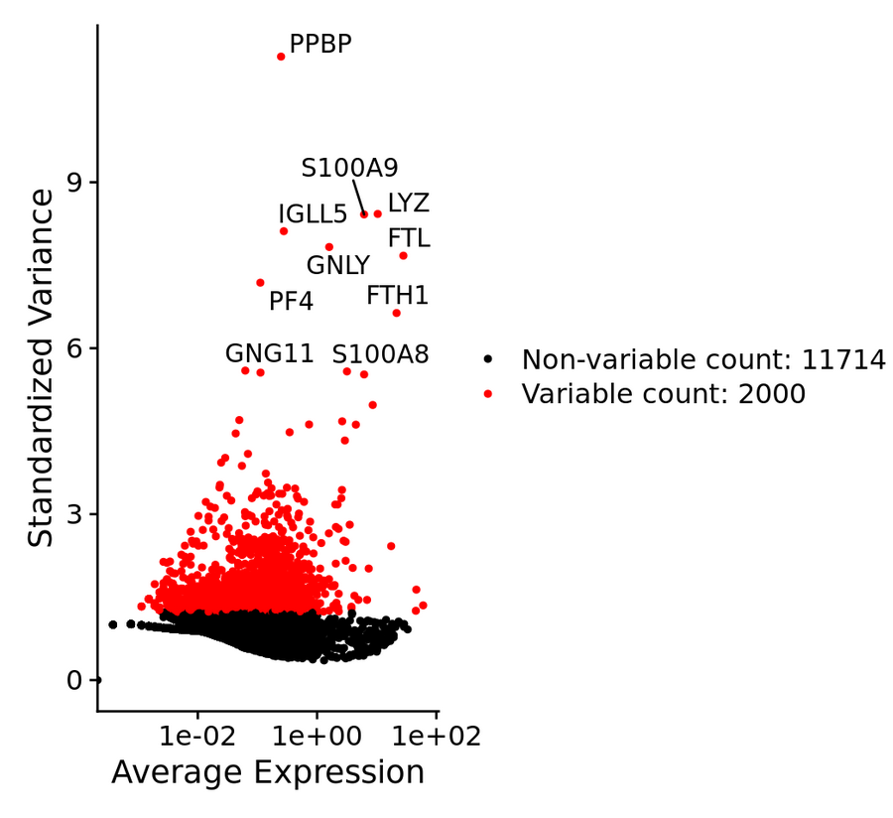
Most common approach currently: To select highly variable genes
Data must be properly normalized before selection
Standard workflow of Seurat uses log-normalization followed by a variance stabilizing transform for selection
SCTransform normalizes and selects highly variable genes in one step
May miss genes relevant only to rare cell types
(Figure from the Satija lab website)
Notes:
References:
Brennecke P. et al. (2013) Accounting for technical noise in single-cell RNA-seq experiments. Nat. Methods, 10, 1093–1095.
Amezquita, R.A., Lun, A.T.L., Becht, E. et al. Orchestrating single-cell analysis with Bioconductor. Nat Methods 17, 137–145 (2020). https://doi.org/10.1038/s41592-019-0654-x

Slide 61
Other approaches
Select highly deviant genes (Townes et al., 2019)
Select genes with high dropout rates (Andrews and Hemberg, 2019)
Select interesting genes based on domain knowledge (Amezquita et al, 2020)
…
Notes:
References:
Townes, F.W., Hicks, S.C., Aryee, M.J. et al. Feature selection and dimension reduction for single-cell RNA-Seq based on a multinomial model. Genome Biol 20, 295 (2019). https://doi.org/10.1186/s13059-019-1861-6
Tallulah S Andrews, Martin Hemberg, M3Drop: dropout-based feature selection for scRNASeq, Bioinformatics, Volume 35, Issue 16, 15 August 2019, Pages 2865–2867, https://doi.org/10.1093/bioinformatics/bty1044
Kiselev, V., Yiu, A. & Hemberg, M. scmap: projection of single-cell RNA-seq data across data sets. Nat Methods 15, 359–362 (2018). https://doi.org/10.1038/nmeth.4644
Ranjan, B., Sun, W., Park, J., Xie, R., Alipour, F., Singhal, V., & Prabhakar, S. (2020). DUBStepR: correlation-based feature selection for clustering single-cell RNA sequencing data. bioRxiv.
Amezquita, R.A., Lun, A.T.L., Becht, E. et al. Orchestrating single-cell analysis with Bioconductor. Nat Methods 17, 137–145 (2020). https://doi.org/10.1038/s41592-019-0654-x

Slide 62
Read counts matrix
✔️
scRNA-seq steps:
✔️
Quality control and filter poor quality cells
Experiment design
✔️
Normalization
✔️
Library preparation
✔️
Feature selection
✔️
Deep sequencing
✔️
Dimensionality reduction
Demultiplex, align and count
(Pre-processing)
Clustering
✔️
…
…
Network analysis
✔️
Find marker genes
Trajectory analysis
Count matrix
Cell-type annotation
Gene set enrichment analysis
Association with phenotypes (e.g., healthy vs diseased)
…
…

Slide 63
6. Dimensionality reduction (30 mins)

Slide 64
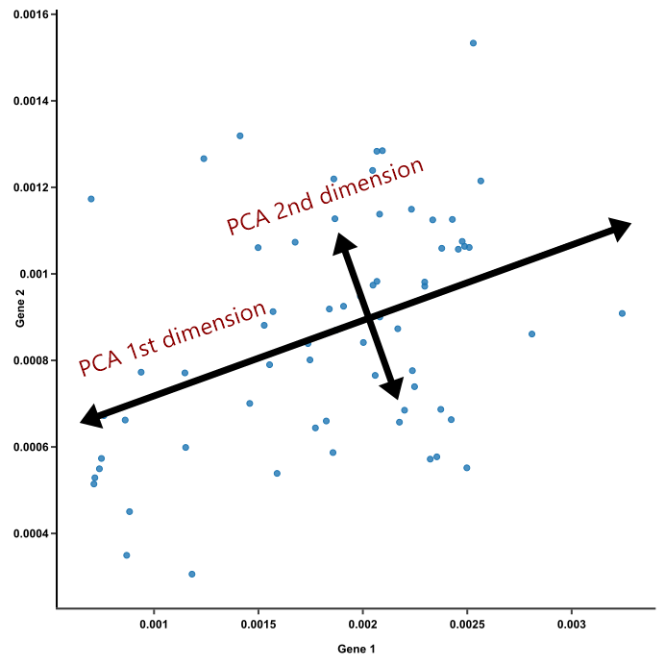
Why reduce dimensions?
a
b
Dimensions = Number of coordinates of data points = Number of genes
=> Too many to visualize
Biological phenomena more likely driven by sets of genes than individual genes
=> Cells may be separated in the direction of hidden “factors”
Ex: 1st dimension could be a disease-associated pathway and the 2nd dimension another hidden factor, e.g., batch effect
Gene #2
Gene #2
Gene #1
Gene #1
c
Gene #2
Gene #1
Notes:
Insights gained from low-dimensional embedding of data must also be tested in higher dimensions:
1. “One might wonder whether the results of such extreme data compression can be trusted. Some of our more quantitative colleagues consider such visualizations to be more artistic than scientific, fit for little but impressing collaborators and reviewers. Perhaps this perspective is not entirely invalid, but we suggest that there is some value to be extracted from them provided that they are accompanied by an analysis of a higher-rank representation.” - Amezquita, R.A., Lun, A.T.L., Becht, E. et al. Orchestrating single-cell analysis with Bioconductor. Nat Methods 17, 137–145 (2020). https://doi.org/10.1038/s41592-019-0654-x
2. Pe’er D., “Dana Pe'er | Single-Cell RNA-sequencing | CGSI 2019”, https://www.youtube.com/watch?v=UGghTbHAvbk

Slide 65
Automated algorithms perform dimensionality reduction
Principal component analysis (PCA) finds directions with largest amount of variation
Many algorithms to perform PCA (for benchmarking comparisons, see Tsuyuzaki et al., 2020)
For scRNA-seq, common to do next steps on top PCs, e.g., top 50
Gene #2
Gene #1
Notes:
References:
1. Tsuyuzaki, Koki, Hiroyuki Sato, Kenta Sato, and Itoshi Nikaido. "Benchmarking principal component analysis for large-scale single-cell RNA-sequencing." Genome biology 21, no. 1 (2020): 9.

Slide 66
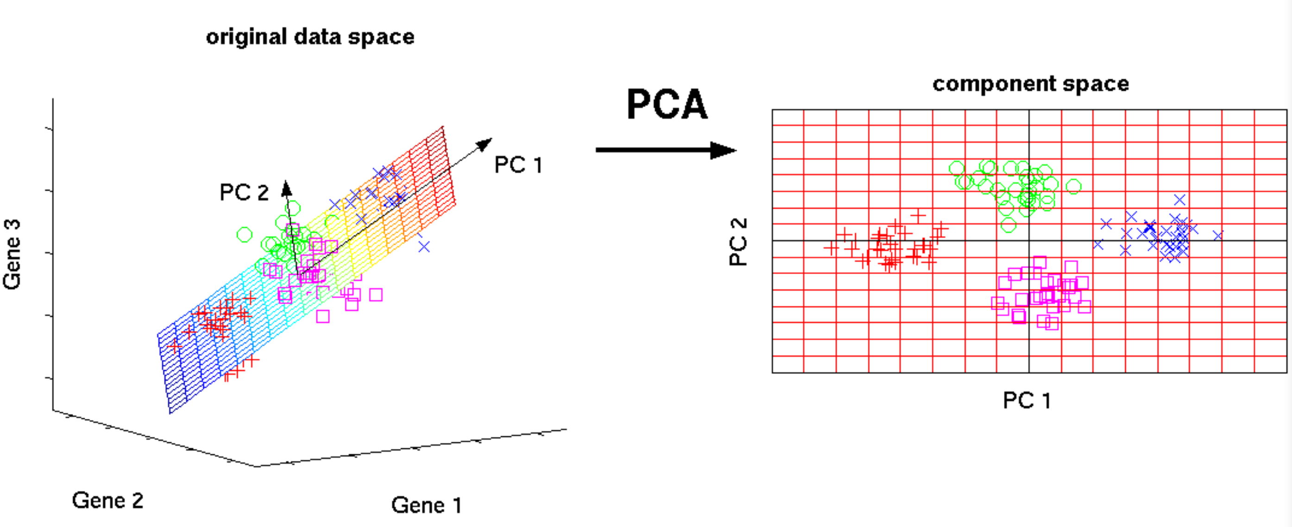
The data can be represented in fewer dimensions than the number of genes
Say, we work with dimensions associated with only the “relevant” factors
=> Useful approximation of complete data
=> Computational efficiency improved
=> Signal-to-noise ratio increased
Common to work with top ~10-15 PCs
Err on the higher side, e.g., 50
Consider exploratory visualizations to determine how many PCs
See the R script
(Link to image source in description)
Notes:
Reference:
https://satijalab.org/seurat/v3.2/pbmc3k_tutorial.html
https://medium.com/@mallrishabh52/principal-components-analysis-7f6ff559cd83

Slide 67
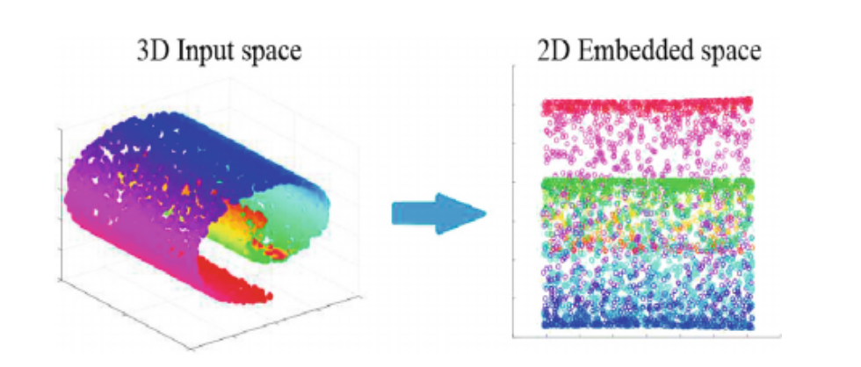
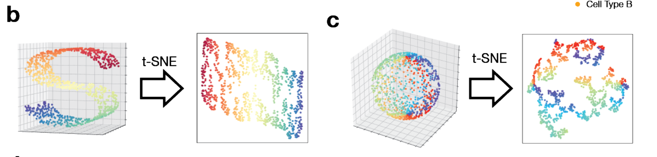
Visualization of single-cell gene expression data commonly utilizes nonlinear dimensionality reduction
Mixing of cell types on linear projection
PCA denoises data but may not meet requirements for visualization
Cells may lie along nonlinear manifolds
linear projection may mix up different cell types
How to visualize depends on the goal of visualization
Goal is view dimensions with largest variance => PCA may be good
Goal is to preserve local structure
=> nonlinear may be projection required
t-SNE preserves local structures
(Images from Salazar-Castro et al., 2018 (top) and Cooley et al, 2020 (bottom))
Notes:
Source of image:
Salazar-Castro, Jose Alejandro, Paul D. Rosero-Montalvo, Diego Fernando Peña-Unigarro, Ana Cristina Umaquinga-Criollo, Zenaida Castillo-Marrero, Edgardo Javier Revelo-Fuelagán, Diego Hernán Peluffo-Ordóñez, and César Germán Castellanos-Domínguez. "A novel color-based data visualization approach using a circular interaction model and dimensionality reduction." In International Symposium on Neural Networks, pp. 557-567. Springer, Cham, 2018.
Cooley, Shamus M., Timothy Hamilton, Eric J. Deeds, and J. Christian J. Ray. "A novel metric reveals previously unrecognized distortion in dimensionality reduction of scRNA-Seq data." BioRxiv (2019): 689851.

Slide 68
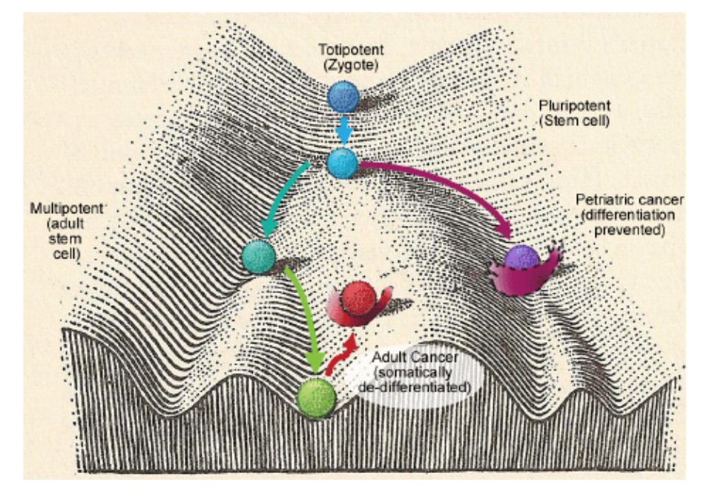
Nonlinear dynamics are commonplace in biological systems
Waddington landscape
Gene regulatory networks contain feedback loops
Nonlinear protein-protein and protein-DNA interactions
Cells are transitioning from one state to another along uneven landscapes
Ex- data lying along noisy loops in gene expression space might hint at oscillatory gene dynamics
(Image from Fels et al., 2015)
Notes:
Reference:
Casey, M. J., Stumpf, P. S., & MacArthur, B. D. (2020). Theory of cell fate. Wiley Interdisciplinary Reviews: Systems Biology and Medicine, 12(2), e1471.
Waddington, C. H. (1939), An introduction to modern genetics. London: George Allen & Unwin.
Fels, D., Cifra, M., & Scholkmann, F. (2015). Fields of the Cell. Research Signpost, Trivandrum, India.

Slide 69
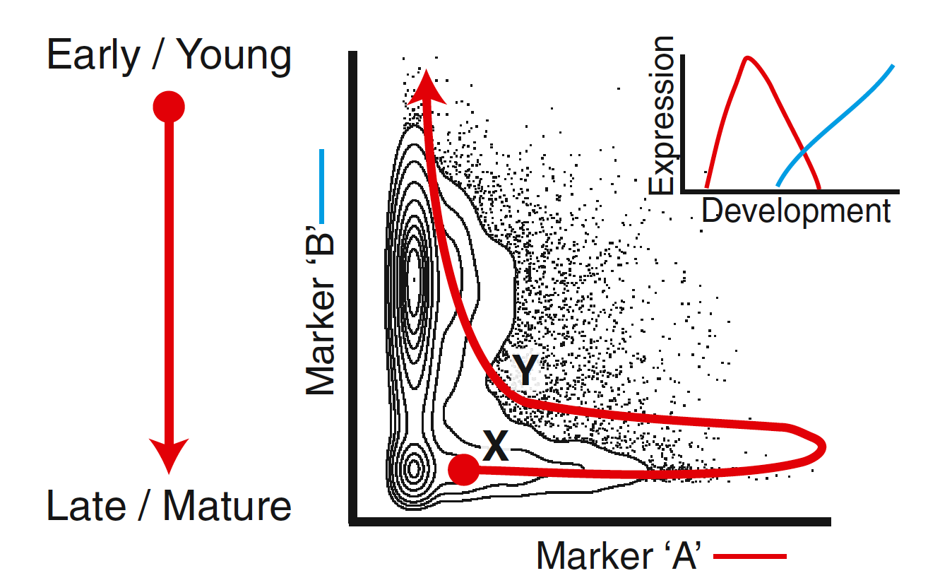
Nonlinear dynamics are commonplace in biological systems
Gene regulatory networks contain feedback loops
Nonlinear protein-protein and protein-DNA interactions
Cells are transitioning from one state to another along uneven landscapes
Ex- data lying along noisy loops in gene expression space might hint at oscillatory gene dynamics
(Image from Bendall et al., 2014)
Notes:
Reference:
1. Bendall, Sean C., Kara L. Davis, El-ad David Amir, Michelle D. Tadmor, Erin F. Simonds, Tiffany J. Chen, Daniel K. Shenfeld, Garry P. Nolan, and Dana Pe’er. "Single-cell trajectory detection uncovers progression and regulatory coordination in human B cell development." Cell 157, no. 3 (2014): 714-725.

Slide 70
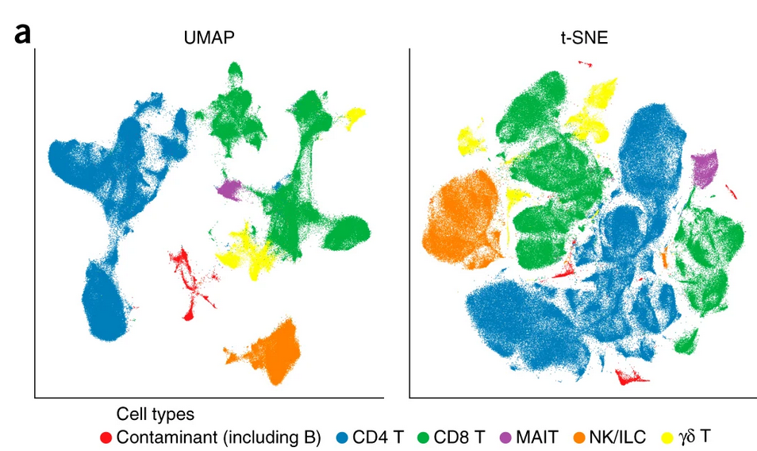

Dimensionality reduction: FAQs
PCA vs tSNE vs UMAP?
Is it art or science or both?
Why the output from yesterday doesn’t match the one from today?
…
(Image source: Becht et al, 2018)
Notes:
Source of images:
1. Becht, E., McInnes, L., Healy, J. et al. Dimensionality reduction for visualizing single-cell data using UMAP. Nat Biotechnol 37, 38–44 (2019). https://doi.org/10.1038/nbt.4314

Slide 71


Eureka! Shortest paths in nearest neighbor graphs work better than Euclidean distance for nonlinear manifolds
(Image from Karam and Campbell, 2013)
Notes:
Source of illustrations:
1. Karam, Z. N., & Campbell, W. M. (2013). Graph embedding for speaker recognition. In Graph Embedding for Pattern Analysis (pp. 229-260). Springer, New York, NY.

Slide 72

Principle underlying t-SNE and UMAP
Given normalized counts, Euclidean distance gives the straight line distance
Transform Euclidean distances into “probability of being neighbor”
Initialize 2D or 3D embedding
Optimize embedding to best preserve relative distances (after transformation)
Various algorithms available, e.g., SNE, t-SNE, UMAP, etc.

Slide 73

t-SNE and UMAP prioritize preservation of distances between neighbors
PCA considers all pairwise distances equally
t-SNE and UMAP prioritize distances between neighbors
(Image from blog by Nikolay Oskolkov on towardsdatascience.com)
Notes:
Recommended reading:
https://towardsdatascience.com/tsne-vs-umap-global-structure-4d8045acba17
https://towardsdatascience.com/how-exactly-umap-works-13e3040e1668
https://www.youtube.com/watch?v=nq6iPZVUxZU

Slide 74
UMAP is better at preserving global structure than t-SNE (?)
t-SNE and UMAP share the same philosophy but differ in design
UMAP uses cross-entropy as cost function while t-SNE uses KL divergence
=> UMAP focuses on both local and global structure
=> t-SNE only preserves local structure
UMAP uses a different function than t-distribution for probability in low dimensions
(Cost function is given by a formula; values in the following table are arbitrary and meant for illustration only)
Dist-10xD | Dist-2D | Cost
10.86 | 10.65 | 6860.860
0.875 | 979.86 | 8764.9990
… | … | …
… | … | …
… | … | …
(Image from blog by Nikolay Oskolkov on towardsdatascience.com)

Slide 75


UMAP is better at preserving global structure than t-SNE (?)
t-SNE and UMAP share the same philosophy but differ in design
UMAP uses cross-entropy as cost function while t-SNE uses KL divergence
=> UMAP focuses on both local and global structure
=> t-SNE only preserves local structure
UMAP uses a different function than t-distribution for probability in low dimensions
Cross-entropy
Dist-2D
Dist-10xD
KL divergence
Dist-2D
Dist-10xD
(Image from blog by Nikolay Oskolkov on towardsdatascience.com)

Slide 76

t-SNE vs UMAP and choice of parameter values
Kobak and Berens, 2019 :-
Default UMAP is not necessarily better than t-SNE at preserving global structure
Both depend on hyperparameters and initialization
Authors discuss parameter choices for t-SNE
(Image from blog by Nikolay Oskolkov on towardsdatascience.com)
Notes:
References:
Kobak, Dmitry, and Philipp Berens. "The art of using t-SNE for single-cell transcriptomics." Nature communications 10, no. 1 (2019): 1-14.
Recommended reading:
1. https://towardsdatascience.com/tsne-vs-umap-global-structure-4d8045acba17

Slide 77

UMAP and FIt-SNE faster than others
By default, Seurat runs Barnes-Hut t-SNE, which is slower
Option available to choose FIt-SNE in Seurat
(Image from Becht et al, 2018)
Notes:
Reference:
1. Becht, Etienne, Leland McInnes, John Healy, Charles-Antoine Dutertre, Immanuel WH Kwok, Lai Guan Ng, Florent Ginhoux, and Evan W. Newell. "Dimensionality reduction for visualizing single-cell data using UMAP." Nature biotechnology 37, no. 1 (2019): 38-44.

Slide 78

Parameter settings determine the local/global balance
t-SNE parameters
Use Fit-SNE in R with Seurat to tune parameters other than perplexity
UMAP parameters:
n_neighbors (more neighbors => global structure dominates)
min_dist (large => clusters pack loosely)
(Image from Kobak et al, 2019)
Notes:
References:
Kobak, Dmitry, and Philipp Berens. "The art of using t-SNE for single-cell transcriptomics." Nature communications 10, no. 1 (2019): 1-14.
Andy Coenen, Adam Pearce, “Understanding UMAP”, https://pair-code.github.io/understanding-umap/

Slide 79


Recommendation 1: Consider PCA initialization for t-SNE and UMAP
t-SNE can be made deterministic by PCA initialization
UMAP additionally utilizes stochastic gradient descent for optimization
=> stochastic even with PCA initialization
Should save the seed used to initialize the pseudo-random number generator
Should save the output after running analysis
a
b
(Images from Kobak and Berens, 2019)

Slide 80


Recommendation 2: Consider using an MDS plot of class means in conjunction with t-SNE or UMAP plots (Kobak et al, 2019)
MDS of class means highlights the global structure
t-SNE or UMAP highlights the local structures
a
b
(Images from Kobak and Berens, 2019)

Slide 81
Recommendation 3: Consider quantifying distortion in low-dimensional embedding
Consider quantifying distortion
Verify all hypothesis by analysis in higher dimensions
=> clustering not done in t-SNE space
(Image from Cooley et al, 2020)
Notes:
Reference:
1. Cooley, Shamus M., Timothy Hamilton, Eric J. Deeds, and J. Christian J. Ray. "A novel metric reveals previously unrecognized distortion in dimensionality reduction of scRNA-Seq data." BioRxiv (2019): 689851.
Insights gained from low-dimensional embedding of data must also be tested in higher dimensions:
1. “One might wonder whether the results of such extreme data compression can be trusted. Some of our more quantitative colleagues consider such visualizations to be more artistic than scientific, fit for little but impressing collaborators and reviewers. Perhaps this perspective is not entirely invalid, but we suggest that there is some value to be extracted from them provided that they are accompanied by an analysis of a higher-rank representation.” - Amezquita, R.A., Lun, A.T.L., Becht, E. et al. Orchestrating single-cell analysis with Bioconductor. Nat Methods 17, 137–145 (2020). https://doi.org/10.1038/s41592-019-0654-x
2. Pe’er D., “Dana Pe'er | Single-Cell RNA-sequencing | CGSI 2019”, https://www.youtube.com/watch?v=UGghTbHAvbk

Slide 82
Patterns that we see in low-dimensional embedding can be new biology or artifacts
Rare cell type?
Distortion?
Doublets?
Dead cells?
Empty drops?
…
What’s that?
a
b
(Images from Kobak and Berens, 2019)

Slide 83
Additional consideration: Log-normalized scRNA-seq data violate assumptions underlying the regular PCA => GLM-PCA by Townes et al., 2019
Centering and scaling data prior to regular PCA
= Specifying a null model of constant gene expression across cells assuming a normal distribution (Townes et al.)
Notes:
References:
Townes, F.W., Hicks, S.C., Aryee, M.J. et al. Feature selection and dimension reduction for single-cell RNA-Seq based on a multinomial model. Genome Biol 20, 295 (2019). https://doi.org/10.1186/s13059-019-1861-6
Svensson, V. Droplet scRNA-seq is not zero-inflated. Nat Biotechnol 38, 147–150 (2020). https://doi.org/10.1038/s41587-019-0379-5

Slide 84
Dimensionality reduction of scRNA-seq data is an active area of research
GLM-PCA by Townes et al., 2019
Ge et al., 2020 report a method that can handle batch effects
…
Notes:
References:
Townes, F.W., Hicks, S.C., Aryee, M.J. et al. Feature selection and dimension reduction for single-cell RNA-Seq based on a multinomial model. Genome Biol 20, 295 (2019). https://doi.org/10.1186/s13059-019-1861-6
Ge, Songwei, Haohan Wang, Amir Alavi, Eric Xing, and Ziv Bar-Joseph. "Supervised Adversarial Alignment of Single-Cell RNA-seq Data." In International Conference on Research in Computational Molecular Biology, pp. 72-87. Springer, Cham, 2020.

Slide 85


The art of dimensionality reduction
Dimensionality reduction algorithms are to scRNA-seq data as lens are to a specimen in imaging
Goal should be to identify biologically relevant dimensions and not blindly reduce dimensions
(PCA
t-SNE-1
t-SNE-2)
High-dimensional data
2D image that prioritizes local view and keeps global view wherever possible
(MDS of cluster centers)
Cluster centers
global view of relative cluster locations projected in 2D

Slide 86
Dimensionality reduction: FAQs
✔️
tSNE vs UMAP?
Is it art or is it science?
Why the output from yesterday doesn’t match the one from today?
…
✔️
✔️
(Image source: Becht et al, 2018)
Notes:
Source of images:
1. Becht, E., McInnes, L., Healy, J. et al. Dimensionality reduction for visualizing single-cell data using UMAP. Nat Biotechnol 37, 38–44 (2019). https://doi.org/10.1038/nbt.4314

Slide 87
Read counts matrix
✔️
scRNA-seq steps:
✔️
Quality control and filter poor quality cells
Experiment design
✔️
Normalization
✔️
Library preparation
✔️
Feature selection
✔️
Deep sequencing
✔️
Dimensionality reduction
✔️
Demultiplex, align and count
(Pre-processing)
Clustering
✔️
…
…
Network analysis
✔️
Find marker genes
Trajectory analysis
Count matrix
Cell-type annotation
Gene set enrichment analysis
Association with phenotypes (e.g., healthy vs diseased)
…
…

Slide 88
7. Clustering (20 mins)

Slide 89

Clusters of cells represent cell types
Cells are limited to basin of attraction of their attractor states
=> Cells of the same type form clusters in gene expression space
(Image from Casey et al, 2020)
Notes:
Reference:
1. Casey, M. J., Stumpf, P. S., & MacArthur, B. D. (2020). Theory of cell fate. Wiley Interdisciplinary Reviews: Systems Biology and Medicine, 12(2), e1471.

Slide 90

Commonly used clustering algorithms may not be appropriate
Assumptions in common algorithms typically do not apply to scRNA-seq
Ex: k-means generates clusters of similar sizes and ~ spherical in shape
but basins of attraction can have different sizes and complex geometries
K-means on raw data (~15k genes)
K-means on top 30 PCs
Nearby points in t-SNE plot are not always in the same cluster from k-means
(Image from blog by Nikolay Oskolkov on towardsdatascience.com)
Notes:
Reference:
1. Casey, M. J., Stumpf, P. S., & MacArthur, B. D. (2020). Theory of cell fate. Wiley Interdisciplinary Reviews: Systems Biology and Medicine, 12(2), e1471.
Source of image:
https://towardsdatascience.com/tsne-vs-umap-global-structure-4d8045acba17

Slide 91

Seurat finds clusters in two steps: 1. Build shared nearest neighbor graph
Build a k-nearest neighbor graph
Keep only edges between cells that share a neighbor
Adjust the edge weights between any two cells based on similarity
= Shared nearest neighbor graph
More discussion on k-means and nearest neighbor algorithms on Nov. 19
Link to registration in notes
Notes:
Reference:
Xu, Chen, and Zhengchang Su. "Identification of cell types from single-cell transcriptomes using a novel clustering method." Bioinformatics 31, no. 12 (2015): 1974-1980.
Register for a workshop on Machine Learning:
https://gladstone.org/events/machine-learning?utm_source=Gladstone%27s+Internal+Community&utm_campaign=50da7e7155-CAMPAIGN_bioinforma-rna-sec-11-9-10-12-13-20&utm_medium=email&utm_term=0_7040ba1f66-50da7e7155-

Slide 92


Seurat finds clusters in two steps: 2. Community detection (e.g., Louvain algorithm)
”community” = a cluster of cells that are more connected among themselves than with cells of other communities
graph-based clustering detects clusters of arbitrary structures
optimizes modularity
Large modularity => most edges are within clusters
Steps:
Initialize: Every cell is its own community
Take cell from its community and add to another
Evaluate modularity gain
Place cell in community with highest modularity gain
Do for all cells and repeat until no improvement
Modularity
(Image from blog on medium.com)
Notes:
Reference:
Amezquita, R.A., Lun, A.T.L., Becht, E. et al. Orchestrating single-cell analysis with Bioconductor. Nat Methods 17, 137–145 (2020). https://doi.org/10.1038/s41592-019-0654-x
Traag, Vincent A., Ludo Waltman, and Nees Jan van Eck. "From Louvain to Leiden: guaranteeing well-connected communities." Scientific reports 9, no. 1 (2019): 1-12.
Source of image:
https://medium.com/walmartglobaltech/demystifying-louvains-algorithm-and-its-implementation-in-gpu-9a07cdd3b010

Slide 93
Note:
Control resolution parameter in FindClusters to tune number of clusters
Cells belonging to the same cluster should co-localize on the t-SNE and UMAP plots
Results depend on feature selection, normalization, similarity metric, clustering algorithm, etc.

Slide 94


Louvain may identify disconnected communities => Leiden developed to address this
Other clustering methods:
Walktrap
Label propagation
Fast-greedy
…
c)
(Image by Traag et al, 2019)
Notes:
Suggested reading:
Blondel, V.D., Guillaume, J.-L., Lambiotte, R., & Lefebvre, E. (2008). Fast unfolding of communities in large networks. Journal of Statistical Mechanics: Theory and Experiment, 10, P10008.
Rotta, R., & Noack, A. (2011). Multilevel local search algorithms for modularity clustering. Journal of Experimental Algorithmics, 16(2), article 2.3.
Waltman, L., & Van Eck, N.J. (2013). A smart local moving algorithm for large-scale modularity-based community detection. European Physical Journal B, 86(11), 471.
Traag, Vincent A., Ludo Waltman, and Nees Jan van Eck. "From Louvain to Leiden: guaranteeing well-connected communities." Scientific reports 9, no. 1 (2019): 1-12.
https://www.cwts.nl/blog?article=n-r2u2a4
http://www.leonidzhukov.net/hse/2015/networks/lectures/lecture10.pdf

Slide 95

Refining clustering results by merging or splitting clusters is allowed
Consider redoing feature selection before iterative splitting of clusters
Consider marker gene expression levels to merge clusters
Another practice: use published atlases to identify clusters
(Image from Hie et al, 2020)

Slide 96
Read counts matrix
✔️
scRNA-seq steps:
✔️
Quality control and filter poor quality cells
Experiment design
✔️
Normalization
✔️
Library preparation
✔️
Feature selection
✔️
Deep sequencing
✔️
Dimensionality reduction
✔️
Demultiplex, align and count
(Pre-processing)
Clustering
✔️
✔️
…
…
Network analysis
✔️
Find marker genes
Trajectory analysis
Count matrix
Cell-type annotation
Gene set enrichment analysis
Association with phenotypes (e.g., healthy vs diseased)
…
…

Slide 97
8. Finding marker genes (20 mins)

Slide 98
Find marker genes
See the R script

Slide 99
Seurat options to visualize marker expression
See the R script

Slide 100
Many options to interact with the Seurat object
Visit: https://satijalab.org/seurat/v3.0/interaction_vignette.html

Slide 101
Read counts matrix
✔️
scRNA-seq steps:
✔️
Quality control and filter poor quality cells
Experiment design
✔️
Normalization
✔️
Library preparation
✔️
Feature selection
✔️
Deep sequencing
✔️
Dimensionality reduction
✔️
Demultiplex, align and count
(Pre-processing)
Clustering
✔️
✔️
…
…
✔️
Network analysis
✔️
Find marker genes
Trajectory analysis
Count matrix
Cell-type annotation
Gene set enrichment analysis
Association with phenotypes (e.g., healthy vs diseased)
…
…

Slide 102
Conclusion
Multiple algorithms might be required in the same project
One-size-fits-all solution not available
Observed patterns in data may be new biology or artifacts

Slide 103
Upcoming sessions
Session 3: Advanced discussion on normalization, differential analysis, and batch-correction. (Thurs)
Session 4: Network analysis of single-cell data, additional topics, Q&A. (Fri)
Machine Learning workshop (Nov. 19)

Slide 104
Helpful resources
Wynton Slack channel
ucsf-wynton.slack.com
Gladstone Bioinformatics Core slack channel
https://gladstoneinstitutes.slack.com/archives/C0145F1L7QS
Wynton tutorials
https://github.com/ucsf-wynton/tutorials/wiki

Slide 105
Your feedback is important to us!
https://www.surveymonkey.com/r/RRTZPTC
~3 min.

